Slide 1

WQF7023 Artificial Intelligence Research Project 2
2025/2026 Semester 1
Explainable Demand Forecasting for Retailers using Graph Neural Networks and Temporal Fusion Transformers
Supervisor: ASSOCIATE PROF.TS.DR.Aznul Qalid Bin MD Sabri
Student: 23115588 Maksatbek kyzy Aizhan

Slide 2
Introduction
Research Questions and Research Objectives
Temporal Fusion Transformer
Spatio-Temporal Graph Neural Network
Hybrid GNN-TFT
Summary
Content of the Presentation

Slide 3

Introduction
Demand forecasting is central to retail success, enabling efficient inventory and resource management.
Complex supply chains and logistics increase the need for advanced, AI-driven forecasting models.
This research explores GNN, TFT, hybrid GNN-TFT models, prioritizing both predictive accuracy and model explainability.
Explainable AI builds trust and transparency, ensuring retail stakeholders can understand and act on model insights.

Slide 4

Research Questions and Objectives
1
2
3
Which approach yields higher accuracy in retail demand forecasting: GNN, TFT, or a hybrid GNN-TFT model?
To evaluate and compare the forecasting accuracy of GNN, TFT, and hybrid GNN-TFT models.
Which features within the retail dataset have the greatest and least impact on the predictive accuracy of these models?
To interpret model predictions by applying both model-specific and model-agnostic explainable AI (XAI) methods.
What architectural improvements are most effective for optimizing the performances of models?
To find and implement architectural improvements, aiming to maximize predictive performance and operational value of models.

Slide 5
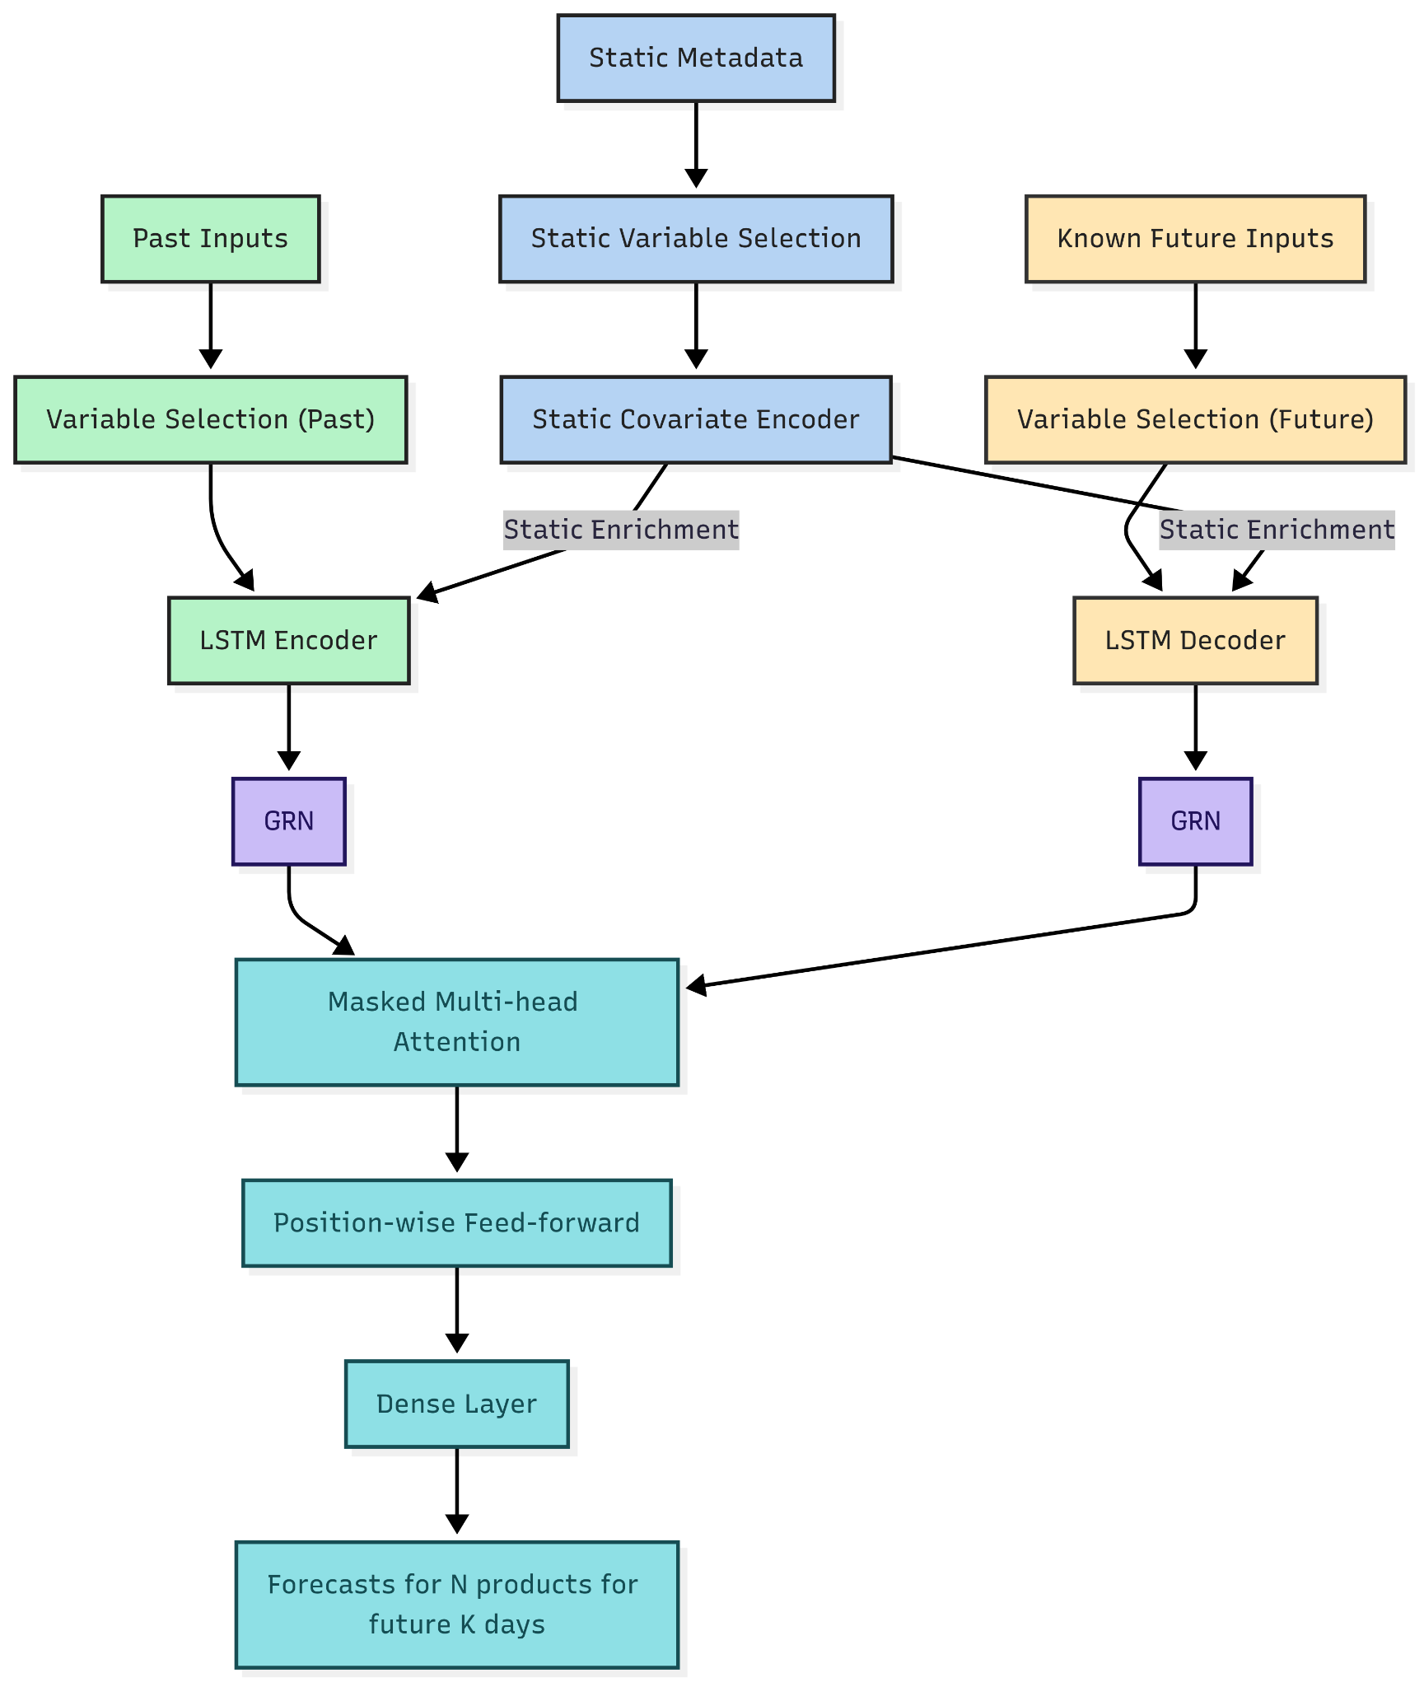
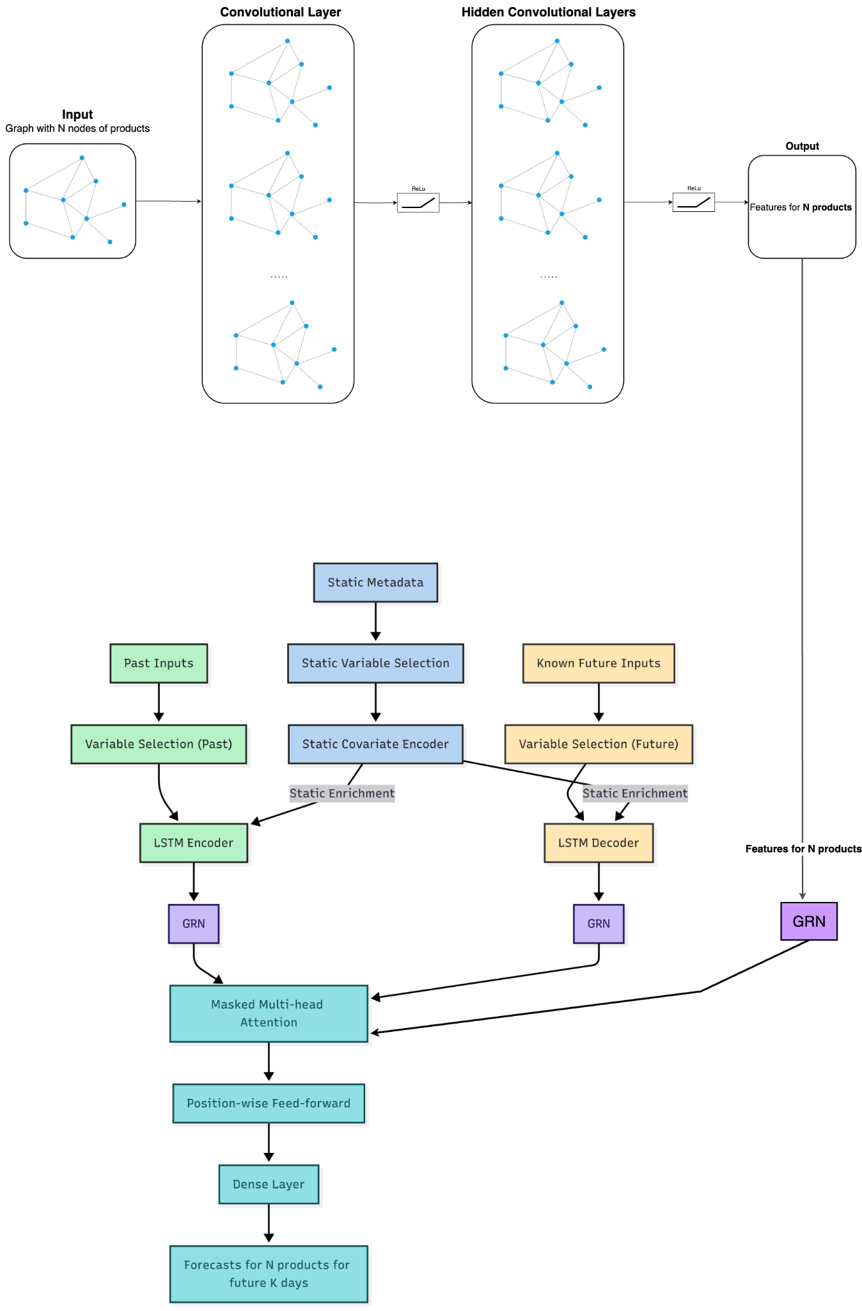
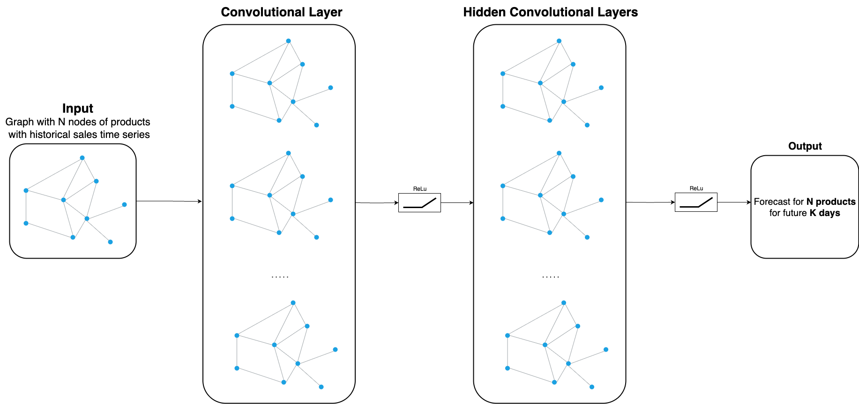
Model Architectures
TFT
GNN
Hybrid GNN-TFT

Slide 6
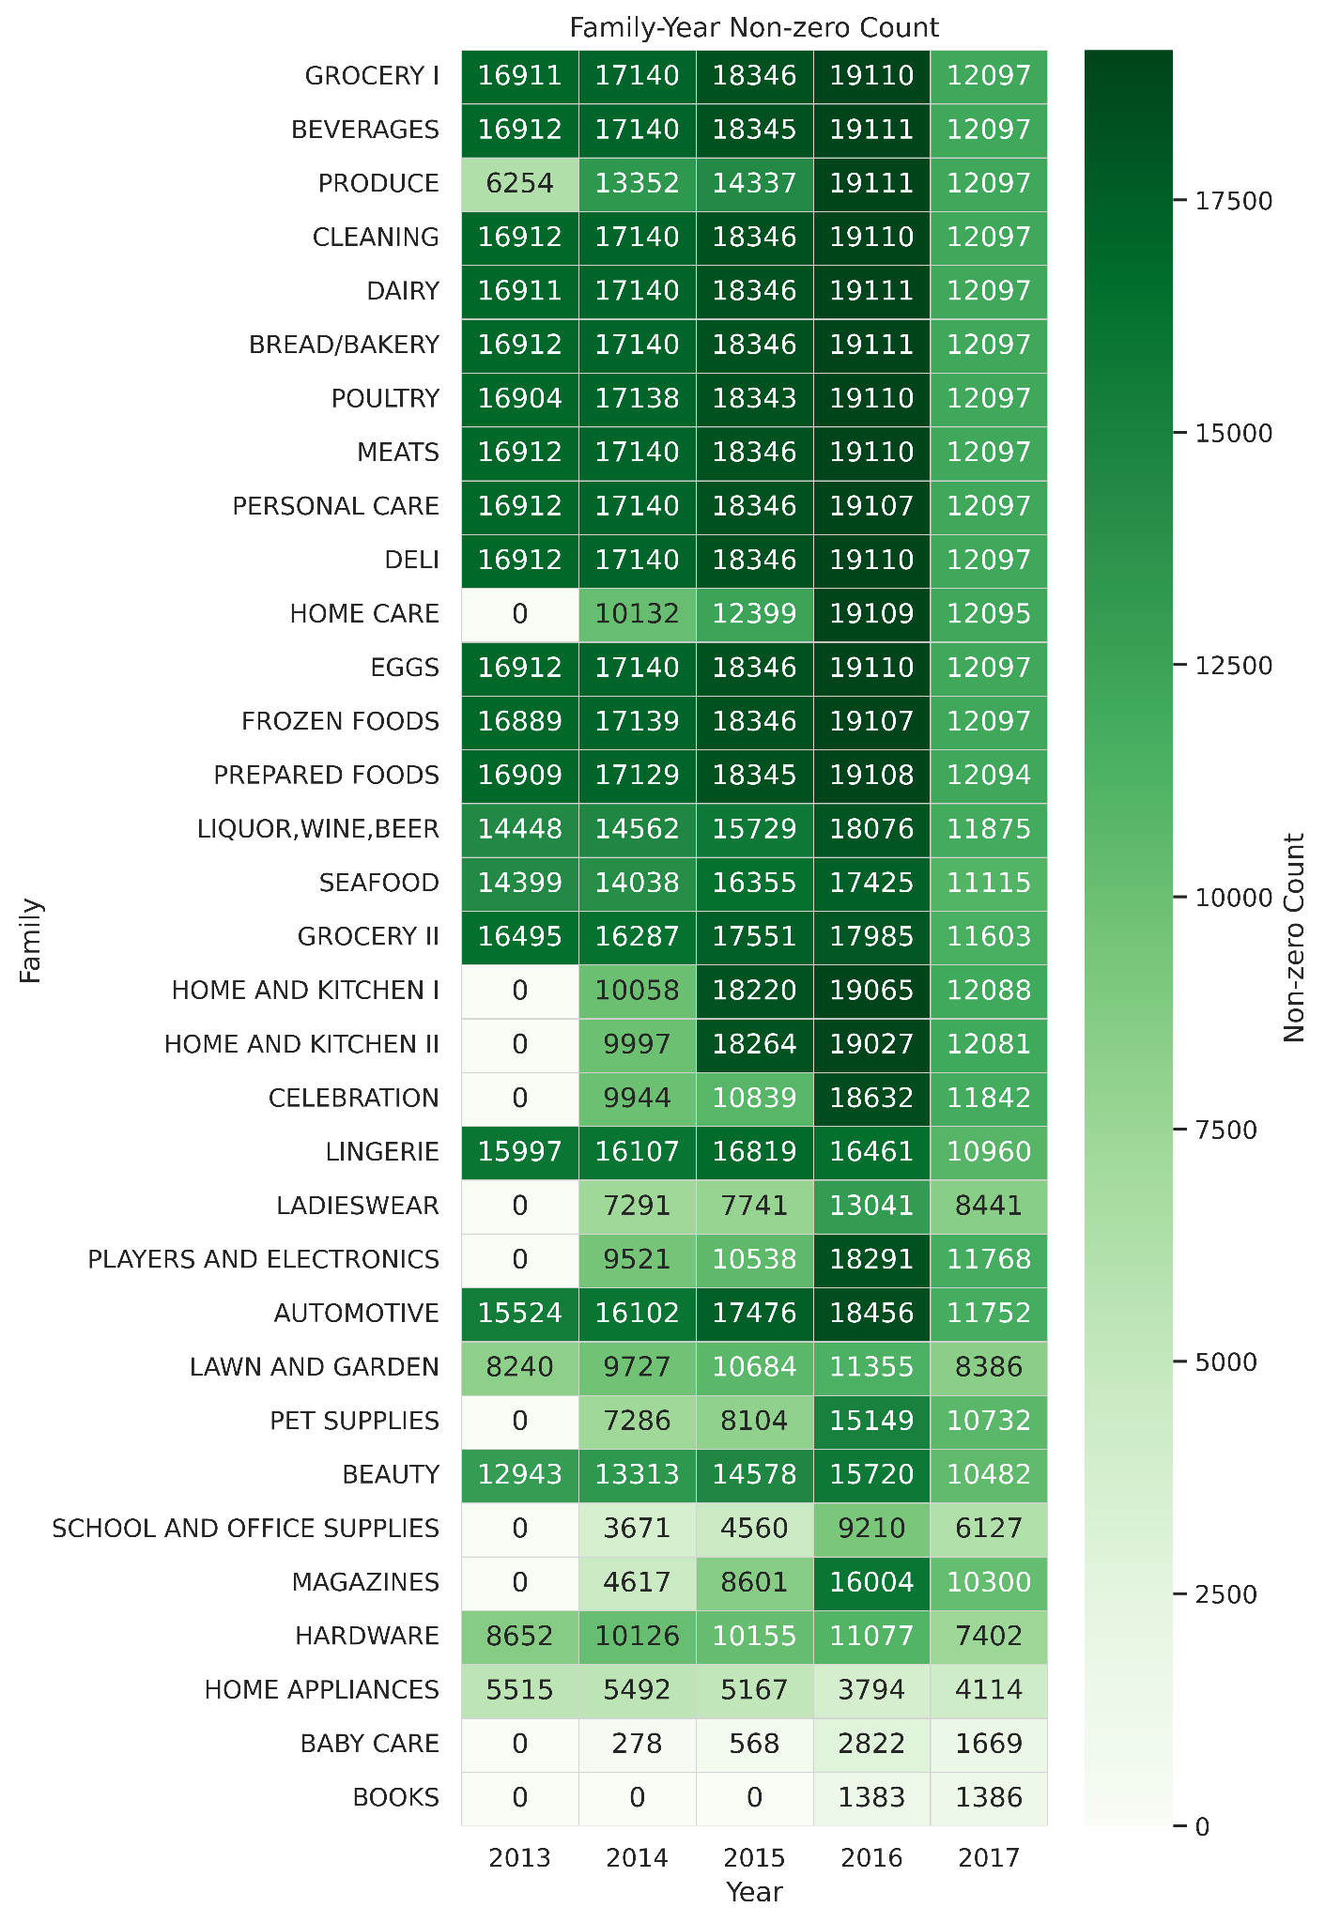
33 - product families
54 - stores
5 - store types
17 - store clusters
22 - states
Data - Favorita Grocery
grocery and household have high daily non-zero sales from 2013 to 2016, with a peak in 2016 and a drop in 2017
home care, baby care and books either started later or have much sparser sales

Slide 7
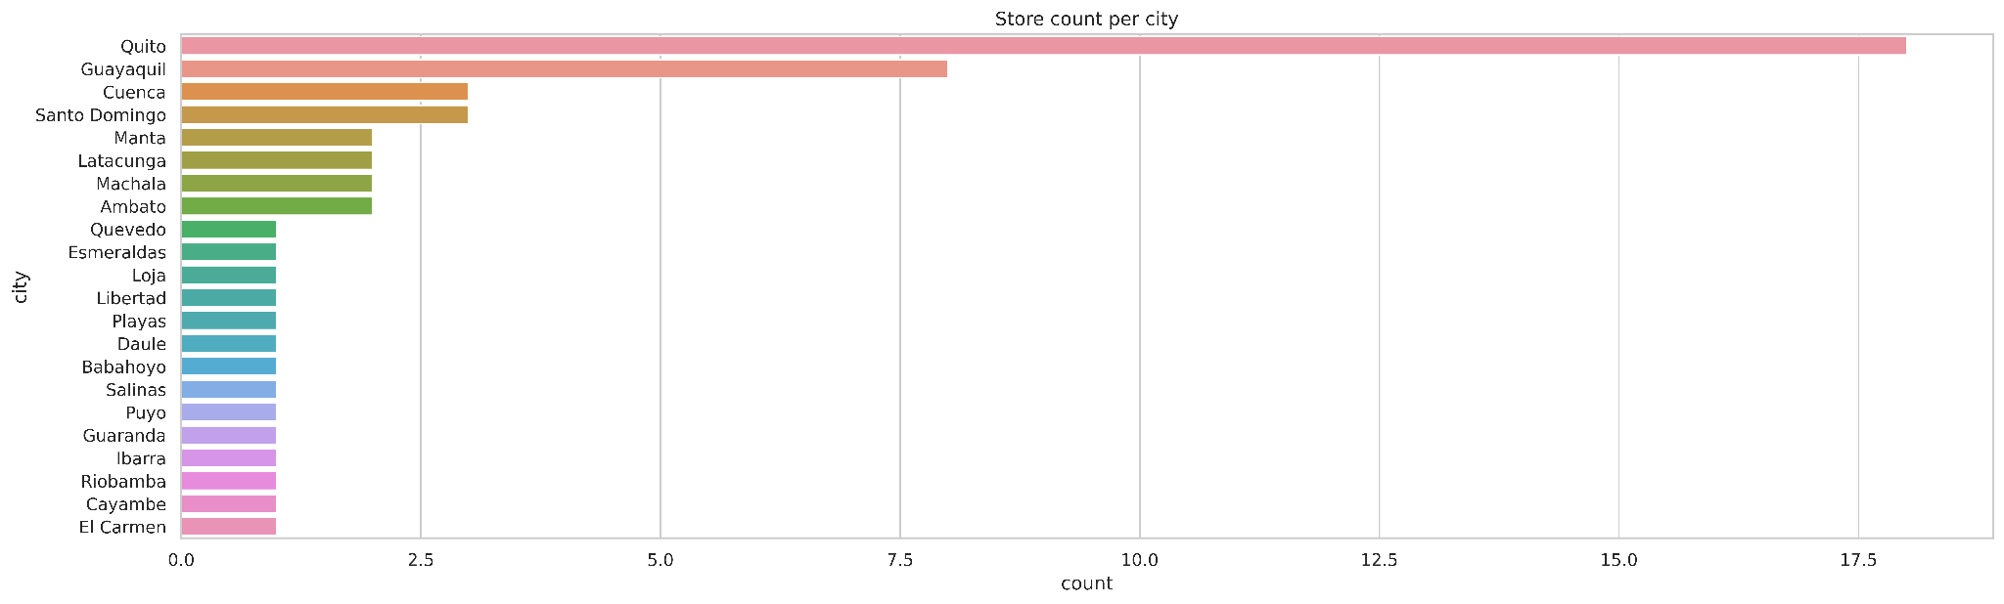
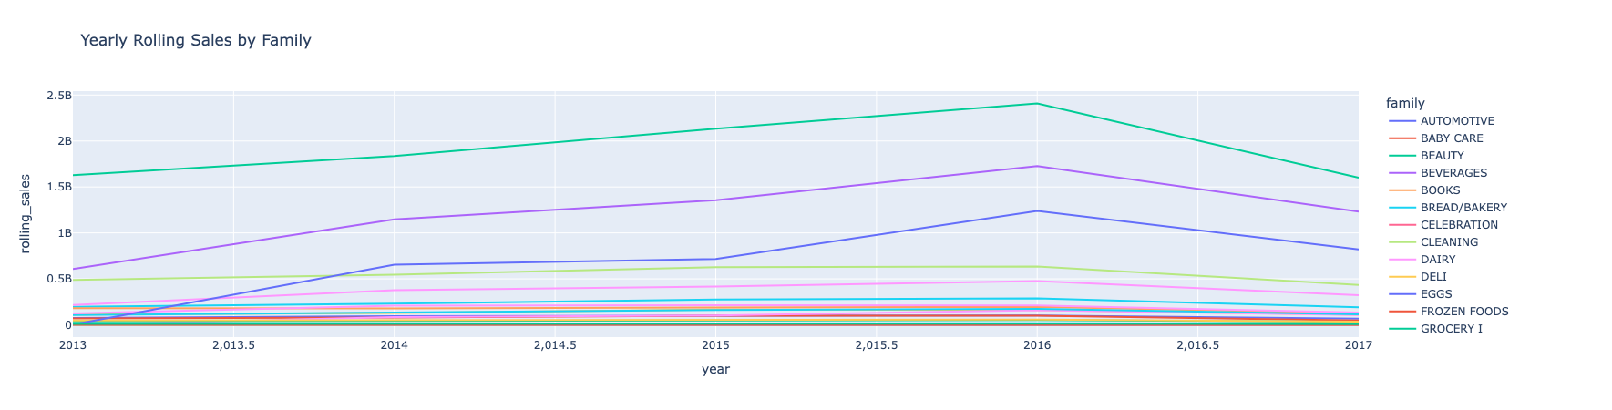
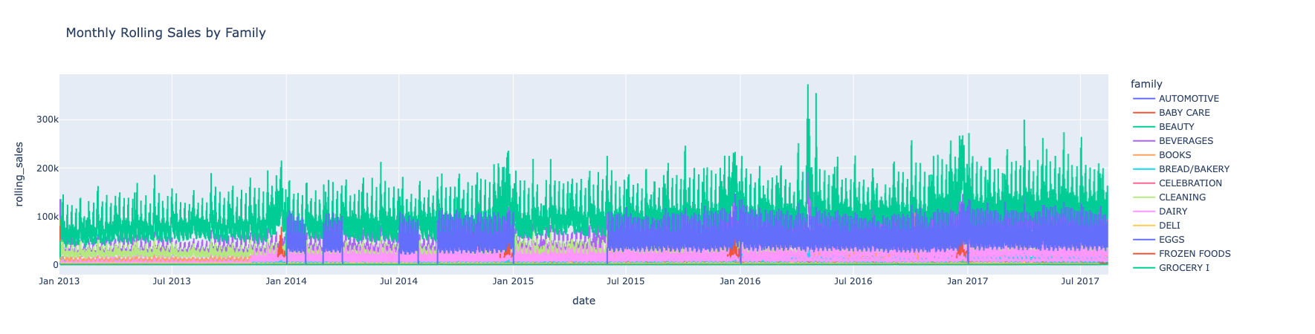
A high number of stores are located in Quito among 22 cities with significant differences showing the imbalance of sales in the dataset across cities.
The heatmap in Figure 5.6 shows that core grocery and household product families have consistently high daily non-zero sales from 2013 to 2016, with a peak in 2016 and a drop in 2017. Other categories, such as HOME CARE, BABY CARE, and BOOKS, either started later or have much sparser sales.
Figure 5.9 and Figure 5.10 illustrate the temporal sales trends at yearly and monthly frequencies, evidencing persistent seasonality, some spikes, and the overall stability characterizing most product families.
Amount of sales over a periodic duration window for the different product families

Slide 8
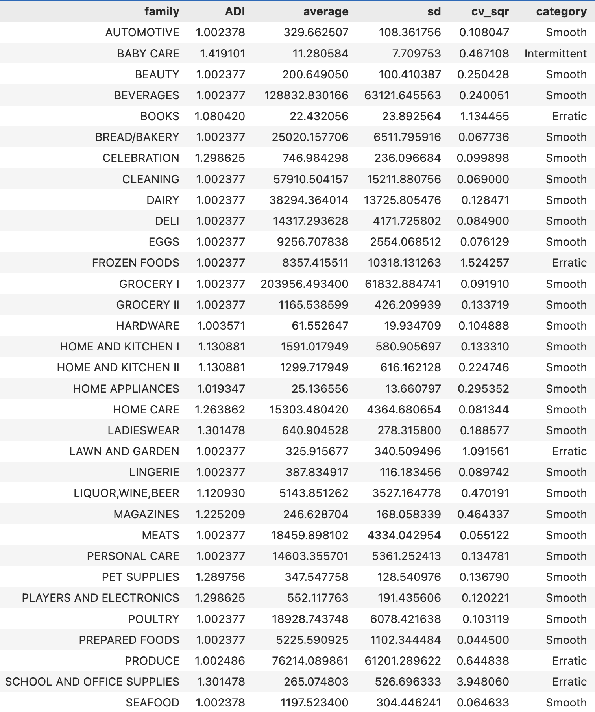
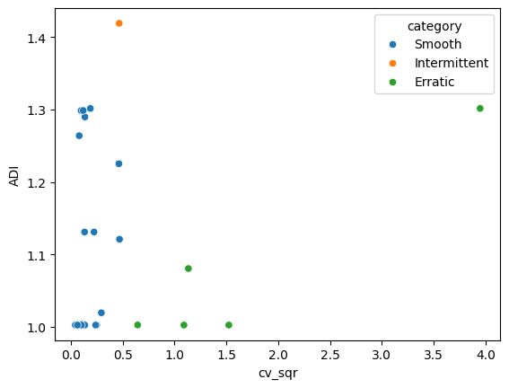
Forecastability
Average demand interval
squared Coefficient of Variation
Type | Range | Description
Smooth | ADI < 1.32 CV² < 0.49 | Demand is regular both in timing and magnitude. Forecasts are relatively straightforward, with low expected error.
Intermittent | ADI ≥ 1.32 CV² < 0.49 | Quantities exhibit little variation, but the intervals between demands are irregular and often lengthy. While specialized methods address intermittency, forecast errors tend to be higher.
Erratic | ADI < 1.32 CV² ≥ 0.49 | Demand occurs at regular intervals, but quantities vary substantially. Forecast accuracy is unstable and difficult to maintain.
Lumpy | ADI ≥ 1.32 CV² ≥ 0.49 | High variability is present in both timing and quantity. Producing reliable forecasts is generally infeasible, regardless of the forecasting technique employed.

Slide 9
Prediction Model Scope: Category vs. Entire Sales
Developed at the product family (category) level (33 families), not individual SKUs.
Advantages:
Captures robust sales patterns and seasonality due to reduced volatility at the category level.
Yields more stable and accurate forecasts, especially when SKU-level data is sparse or highly variable.
Reduces computing cost significantly compared to building models for each SKU.
Rationale:
Effective as an initial step to understand broad sales trends and optimize resource allocation.
Once established, the approach can be extended to SKU-level forecasting for detailed inventory planning.
Note:
SKU-level forecasting is ultimately preferred by store managers, and can be implemented as data and modeling processes mature.

Slide 10

Results
Baseline Models: ARIMA and Linear Regression
Temporal Fusion Transformers
Spatio-Temporal Graph Neural Networks
Hybrid GNN-TFT

Slide 11
Baseline Models - ARIMA and Linear Regression
The Autoregressive Integrated Moving Average (ARIMA) model is a statistical method for analyzing and forecasting time-series data. In this study, the ARIMA model is implemented with the parameter order (2,1,3), which incorporates past values, applies differencing to remove trends, and leverages past forecast errors to predict future sales (see Section 5.2.1 for details). The results produced by this straightforward forecasting approach serve as the baseline for subsequent model comparisons. Performance is evaluated using three metrics - MAE of 4175.60, WAPE of 0.1630, and SMAPE of 0.3366 - calculated across all 33 product families (see Figure 6.1).
In addition to ARIMA, a basic Linear Regression (LR) model was included as a baseline for comparison. LR is widely used due to its simplicity and its ability to model linear relationships between predictor variables and the target sales variable. This baseline yielded a MAE of 315.74, a WAPE of 0.8446, and a SMAPE of 1.4174.

Slide 12
1
Temporal Fusion Transformer

Slide 13
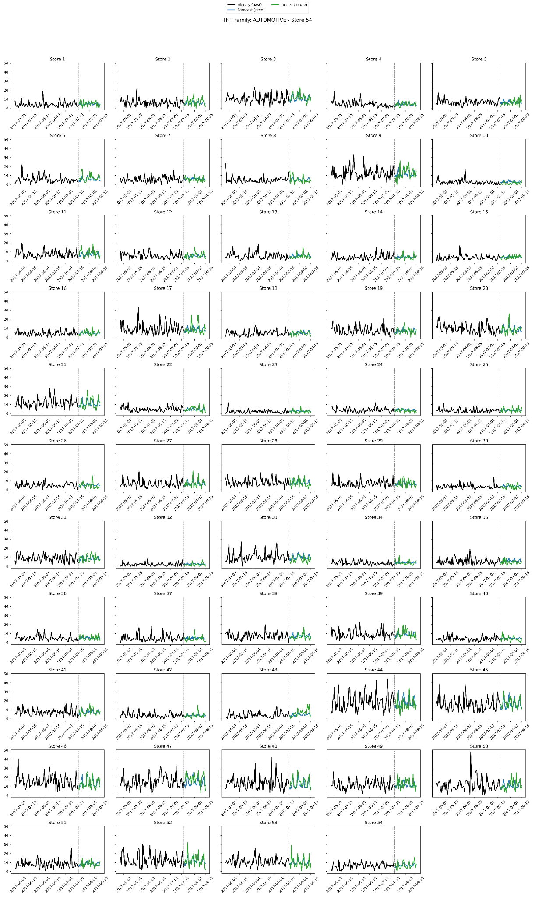
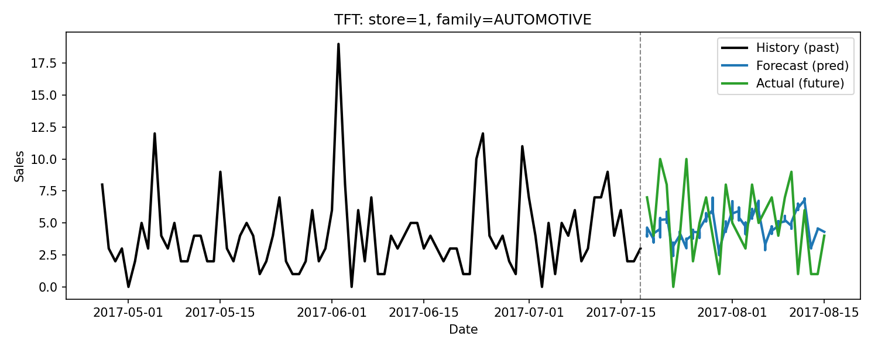
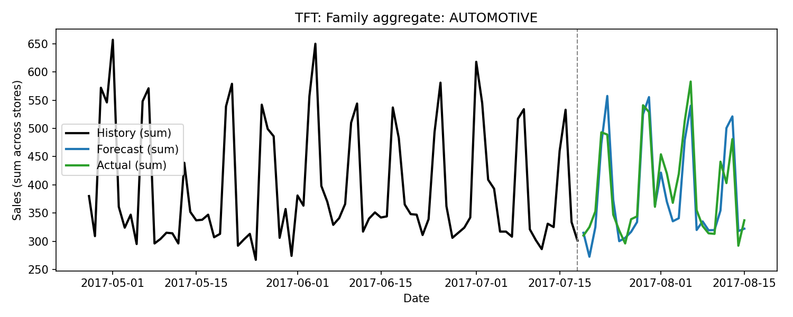
Temporal Fusion Transformer
Figure 6.2 presents the TFT model forecasts for the "Automotive" product type in store 1, while Figure 6.3 illustrates the forecasts for this product across all stores. Further detailed forecasts for each individual store are provided in Appendix

Slide 14
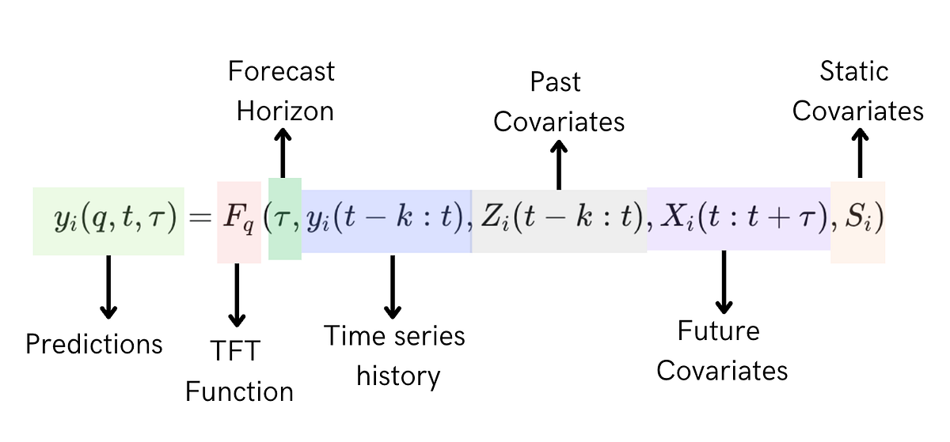
TFT Input Data
Image Reference: Medium
The TFT architecture requires three categories of input features: observed features from the past, known future inputs, and static features, as summarized in Table 6.1.
A sliding window mechanism provides the model with input-target pairs for each anchor time point t during training, validation and testing.
Feature Category | Feature Name
Past observed (9 total) | sales transactions daily oil price promotion day of the week month week of the year holiday workday
Known future (6 total) | promotion day of the week month week of the year holiday workday
Static (4 total) | store number product family store state store cluster

Slide 15
Model-Agnostic XAI:
Permutation Importance
Space | Variable | ΔWAPE
Decoder (future) | onpromotion | 0.1053
 | dow | 0.0216
 | month | 0.0130
 | weekofyear | 0.0107
 | is_holiday | 0.0024
 | is_workday | 0
Encoder (historical) | sales | 0.0280
 | transactions | 0.0020
 | onpromotion | 0.0018
 | is_holiday | 0.0002
 | dow | 0.0001
 | is_workday | 0
 | weekofyear | -0.0001
 | month | -0.0004
 | dcoilwtico | -0.0016
Static | state | ~0
 | cluster | ~0
 | family | ~0
 | store_nbr | ~0
As shown in Table 6.2, among decoder (future) variables, “onpromotion” causes the greatest increase in WAPE, indicating that it is the most critical feature for forecast accuracy. For encoder (historical) features, “sales” is the most important, while “transactions” and “onpromotion” have smaller effects. Static features, such as store information and product metadata, have negligible impact on forecast performance.

Slide 16
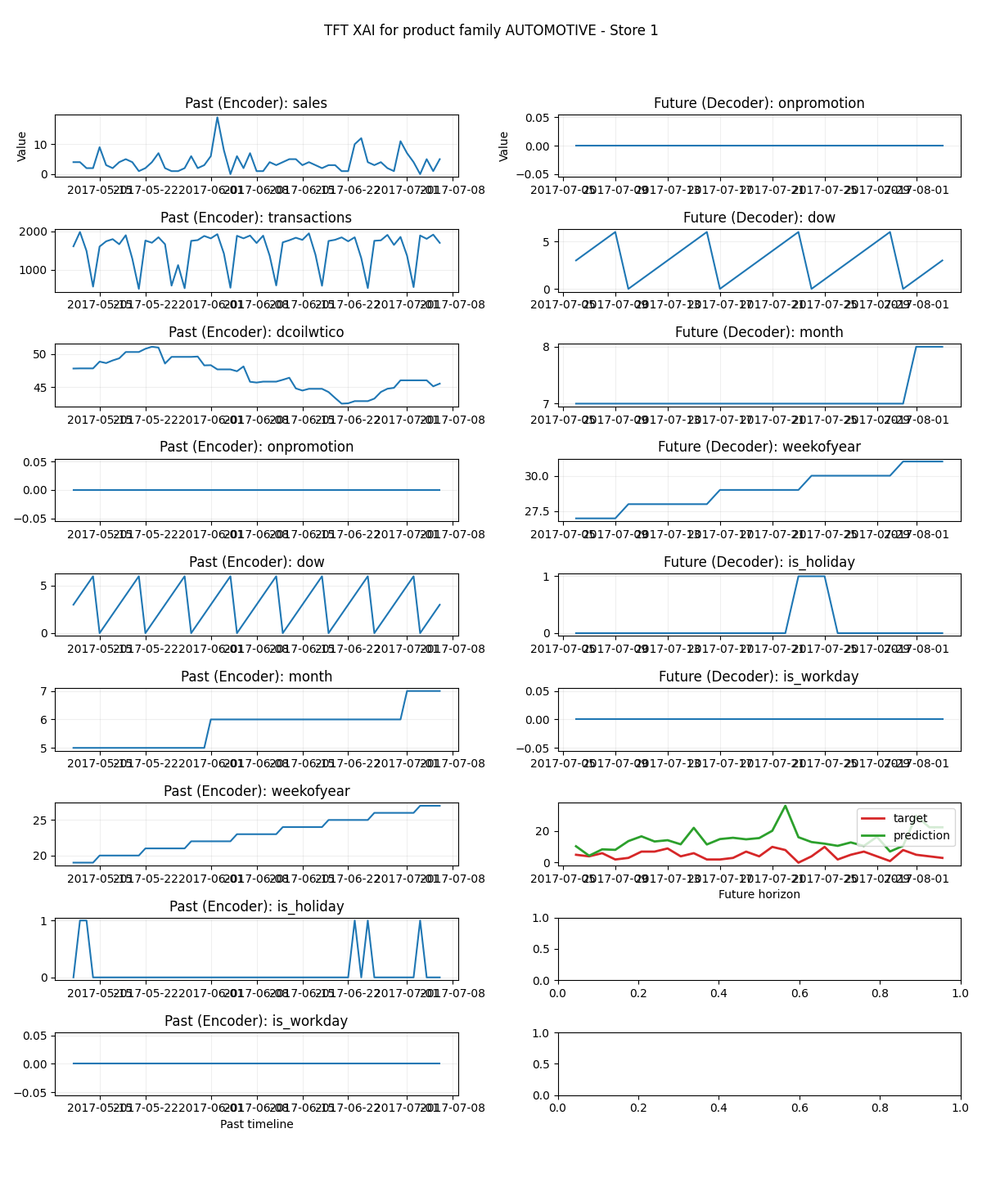
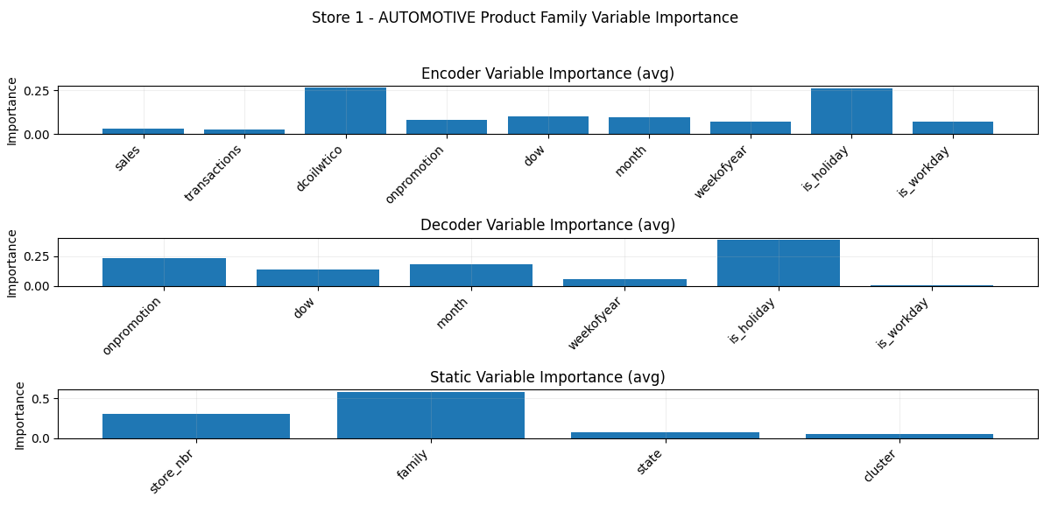
Model-Intrinsic XAI:
Attention and Variable Selection Weights
The internal mechanisms of the TFT architecture offer interpretability through its attention and variable selection networks. After performing inference on the test set, attention maps can be extracted to reveal which temporal segments the model prioritizes during prediction.
The variable selection network (VSN), implemented with gated residual networks, outputs context-dependent weights for encoder (past), decoder (future), and static features. Each feature group is encoded, followed by application of softmax function, resulting weighted sum produces a fused representation with interpretable, per-feature importances.
For example, as shown in Figure 6.4, for the "Automotive" product family in store 1, the highest model-derived variable importances show the holiday, oil price, and family type. Factors such as store state, cluster, sales, transactions, workday, and week of the year had minimal impact, while features such as onpromotion, day of the week, month, week of the year, month, and store number have moderate influence. The Figure 6.5 shows the input data and prediction vs actual results.

Slide 17
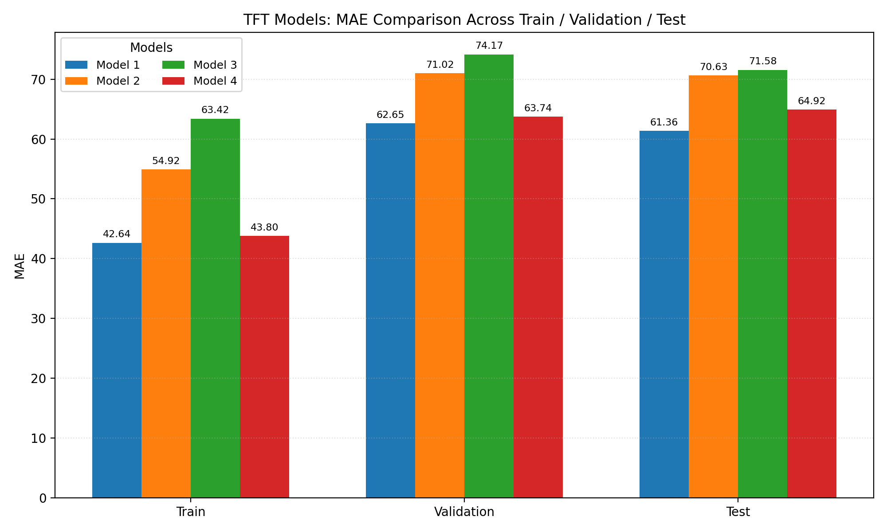
Parameters
--hidden-dim: 128 --d-model: 64 --heads: 4 --lstm-hidden: 64 --lstm-layers: 1 --dropout: 0.1
--hidden-dim: 64 --d-model: 32 --heads: 2 --lstm-hidden: 32 --lstm-layers: 1 --dropout: 0.1
--hidden-dim: 32 --d-model: 16 --heads: 2 --lstm-hidden: 16 --lstm-layers: 1 --dropout: 0.1
--hidden-dim: 256 --d-model: 128 --heads: 8 --lstm-hidden: 128 --lstm-layers: 1 --dropout: 0.3
Model Performance
To compare various combinations of TFT model architectures, an experiment was conducted evaluating four distinct sets of key architectural parameters: hidden layer dimension, embedding dimension, number of attention heads, LSTM hidden state size, and the number of stacked LSTM layers, as detailed in Table 6.3. The findings indicate that the configuration consisting of a hidden layer dimension of 128, an embedding dimension of 64, four attention heads, an LSTM hidden state size of 64, and a single stacked LSTM layer outperformed the other configurations, as evidenced by a MAE of 61.36 (see Figure 6.6).

Slide 18
Spatio-Temporal Graph Neural Network (STGNN)
2
The core of the architecture consists of spatio-temporal blocks. Each spatio-temporal block is composed of temporal and graph convolutional blocks, linear layers, and the ReLU activation function.
The temporal blocks are responsible for capturing the sequential dependencies using dilated, causal, one-dimensional convolutions with causal padding. This ensures that predictions for a given time step are influenced by current and historical data, maintaining temporal causality.
Temporal convolutions operate per node, with shared weights across nodes. The graph convolution blocks capture the spatial relationships by processing the underlying graph structure. At each time-step, a first-order graph convolution is performed according to the equation H = σ(Â X W + b), where Â denotes the normalized adjacency matrix, X represents input model features, W and b are learnable parameters. σ is an activation function ReLU.
Linear layers are used to map hidden representations to the final output predictions, while the ReLU activation function introduces necessary non-linearity into the model.

Slide 19
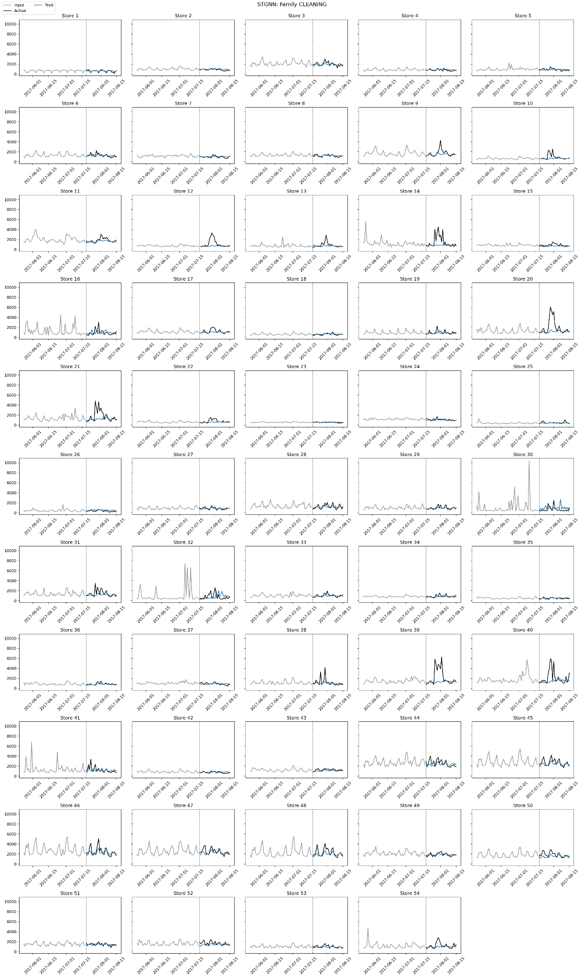
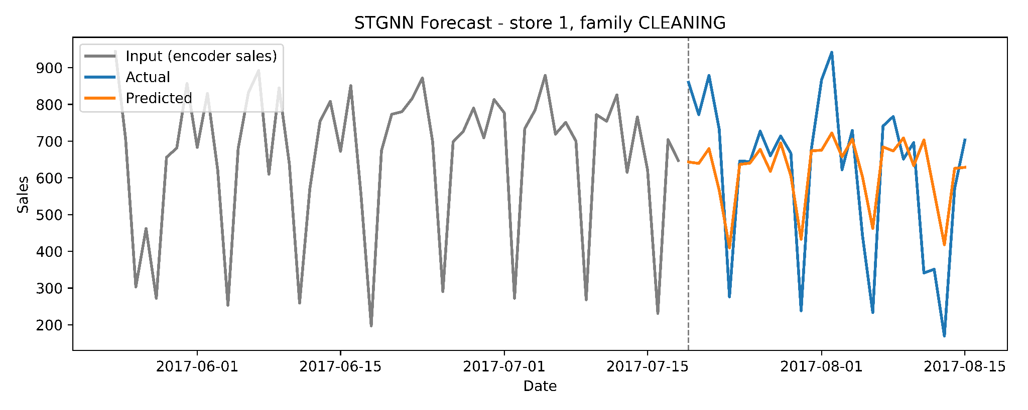
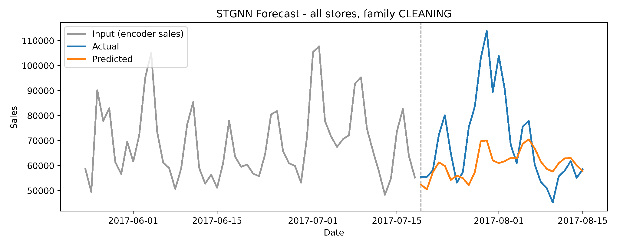
Spatio-Temporal Graph Neural Network
The STGNN is an architecture developed for multi-horizon demand forecasting that effectively captures both spatial and temporal dependencies. It offers an integrated approach to demand forecasting by modeling the interconnected entities - such as product and store features - over multiple time steps. The model processes the feature inputs alongside node information to output demand predictions for the next 28 days. Figure 6.7 illustrates the forecast for the Cleaning product category in Store 1, while Figure 6.8 presents the forecast for Cleaning product across all Favorita stores in Ecuador region. Detailed demand forecasts for each individual store is provided in Appendix E.

Slide 20
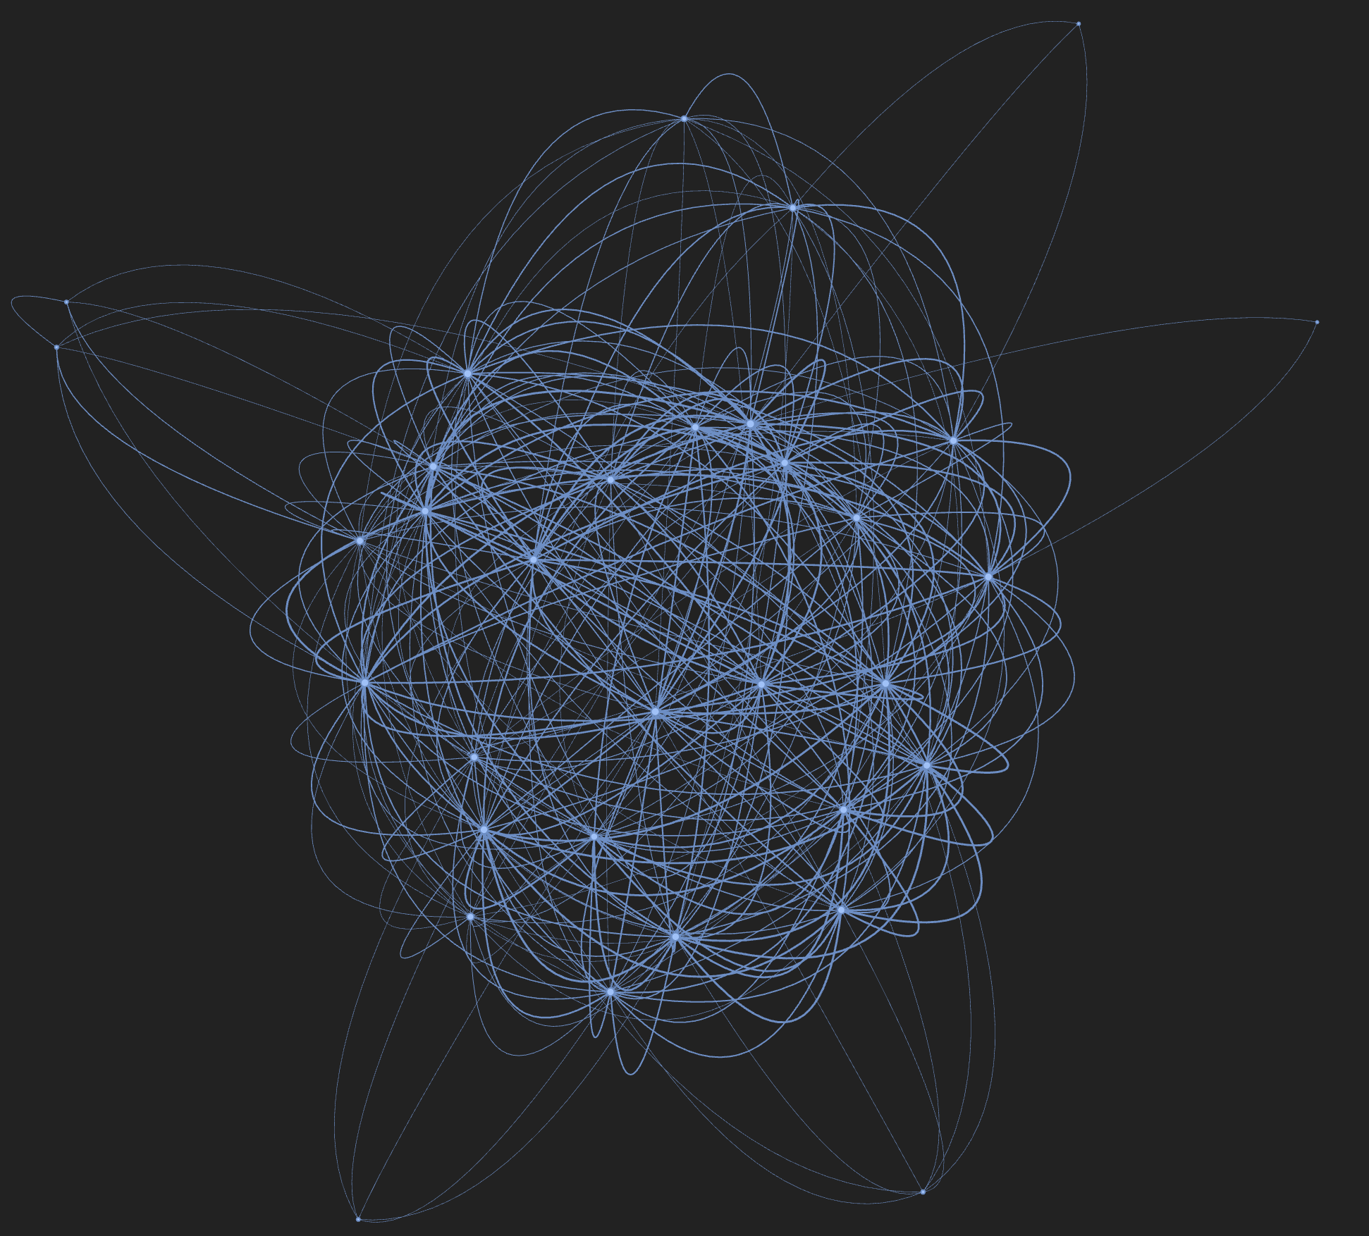
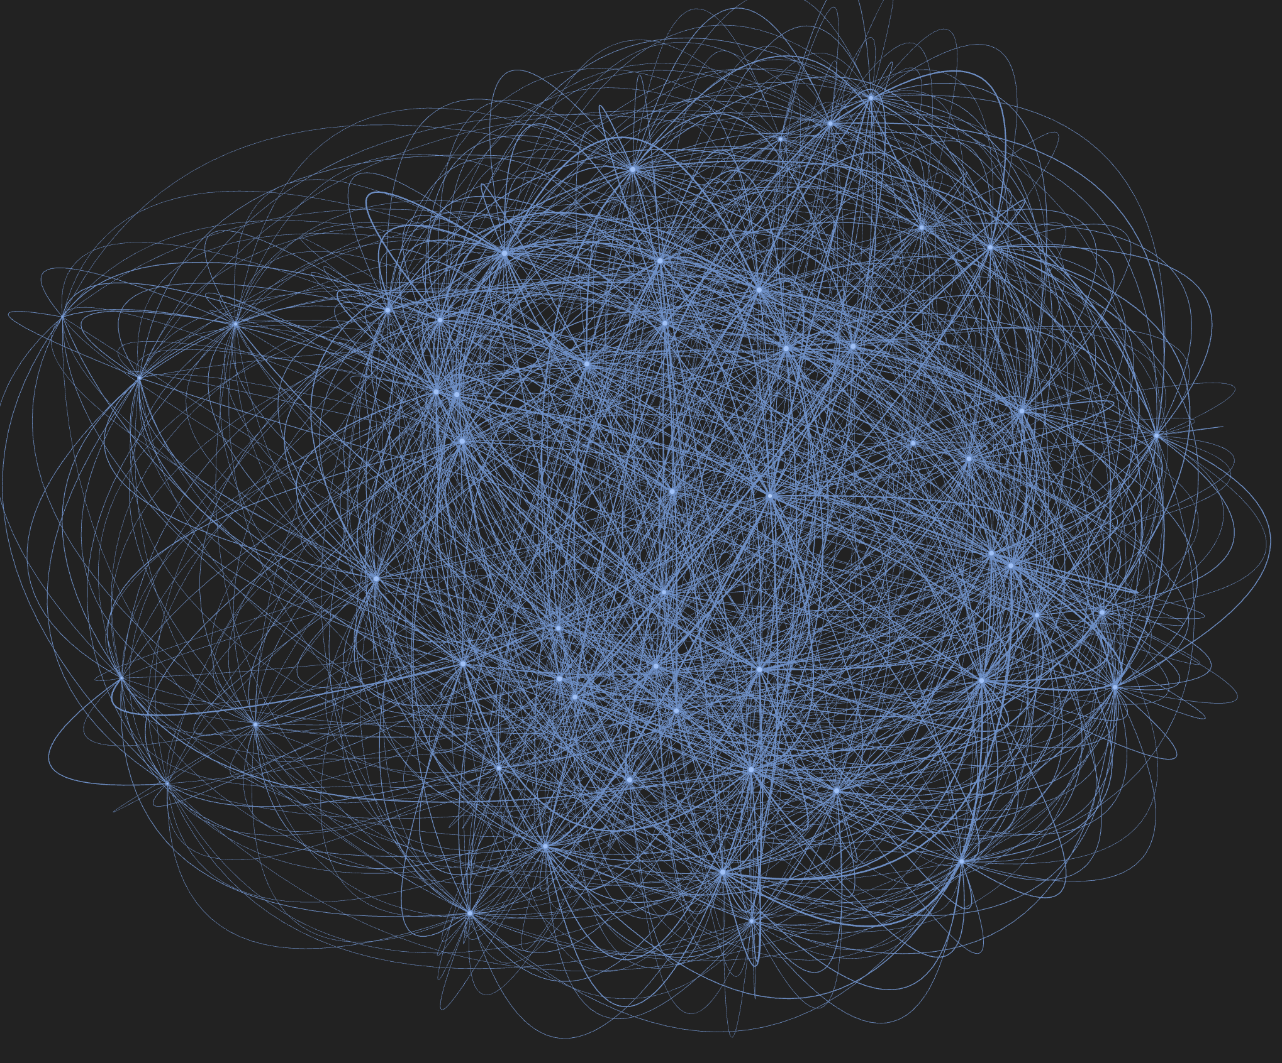
STGNN Data
The spatio-temporal sliding window mechanism is employed to construct training, validation, and test sets for the STGNN model. In this framework, each node in the graph corresponds to a unique (store, family) pair, defined by assigning a unique node identifier to every combination of product family and store within the chronological data.
Feature values for each date and node are organized into matrices, which are subsequently stacked into a three-dimensional tensor with shape [T, N, F], where:
T: Number of dates
N: Number of nodes (distinct pairs of store and family)
F: Number of feature columns
For each (store, family) pair, the feature set includes: store_nbr, family, date, dow, month, weekofyear, id, sales, onpromotion, state, store_type, cluster, transactions, dcoilwtico, is_holiday, is_workday.
T - Dates
N - Nodes (distinct pairs of store and family)
F - Feature columns
Figure 6.2.3.1 Store Graph illustration
Figure 6.2.4.1 Product-Family Graph

Slide 21
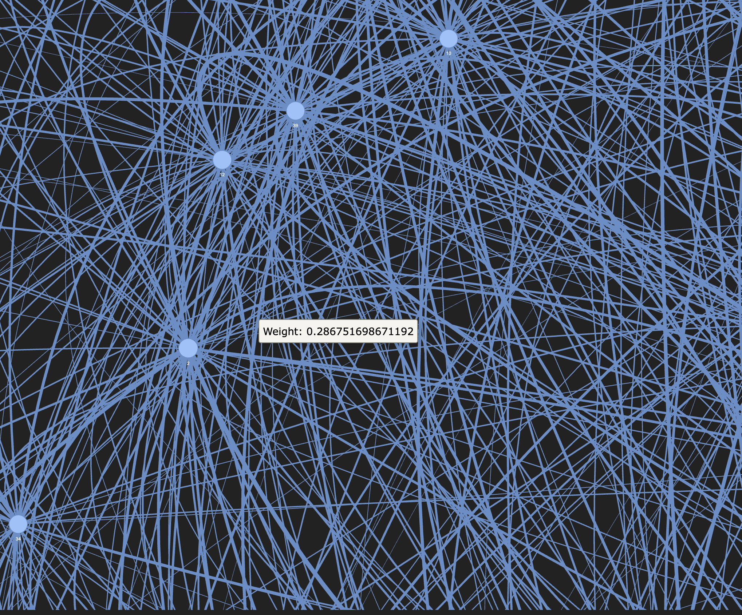
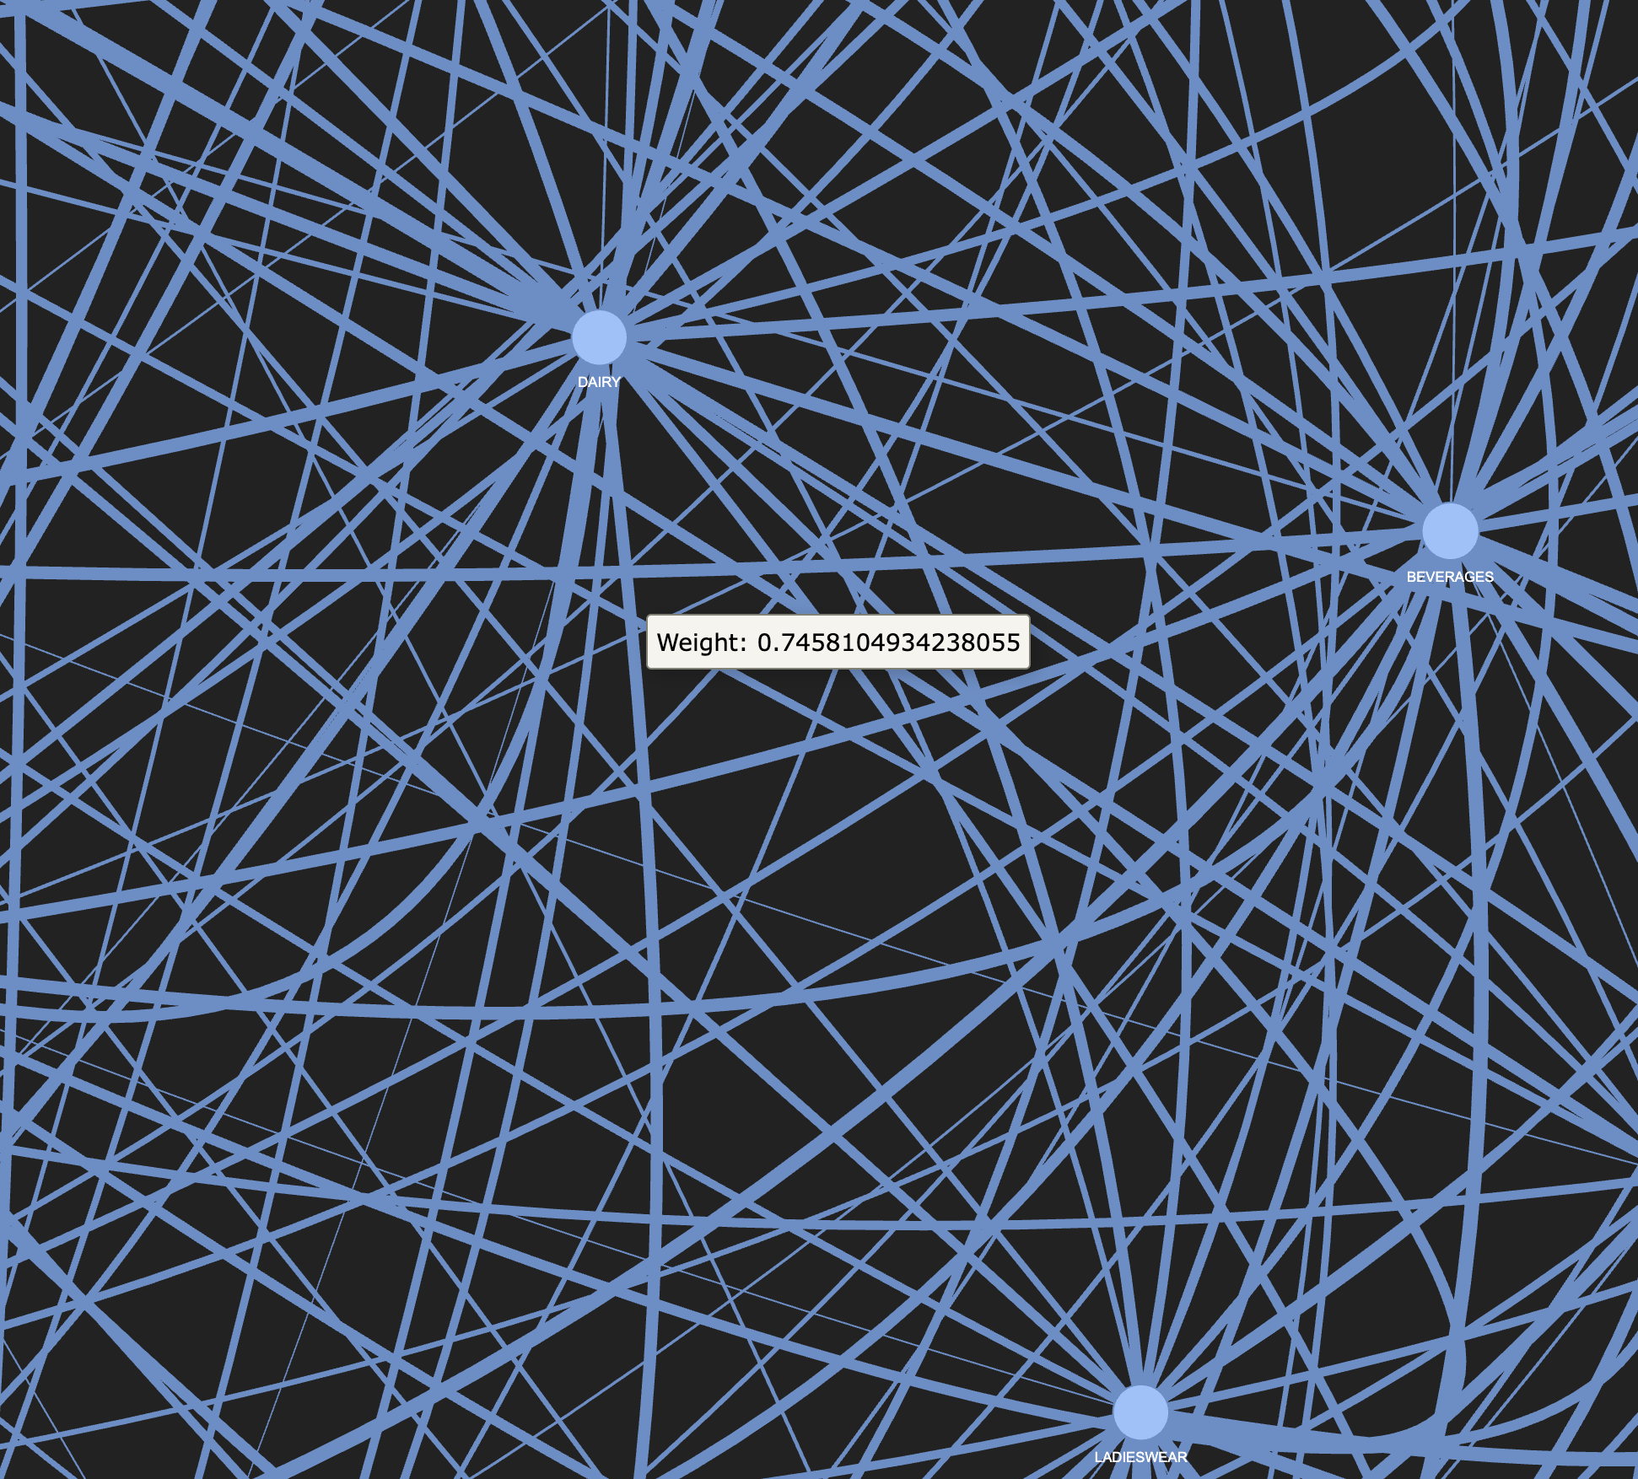
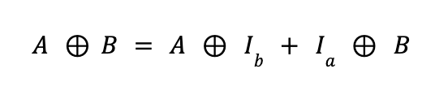
Store Graph
Family Graph
+0.5: if both stores belong to the same cluster
+0.3: if both stores are in the same state
+corr(transactions_a, transactions_b): Pearson correlation of the transaction time series
Pearson correlation coefficient is computed over a 60-day sales window for products (i) and (j)
If the correlation coefficient exceeds 0.3, an undirected edge is established between product (i) and (j), with the correlation value assigned as the weight
Kronecker-Sum

Slide 22
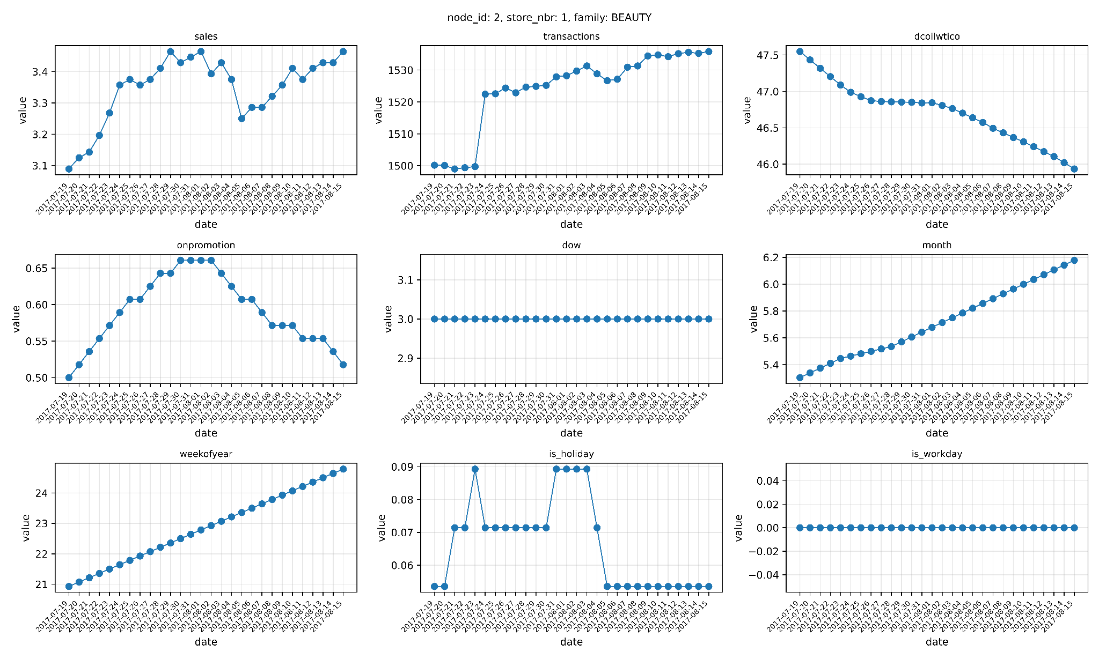
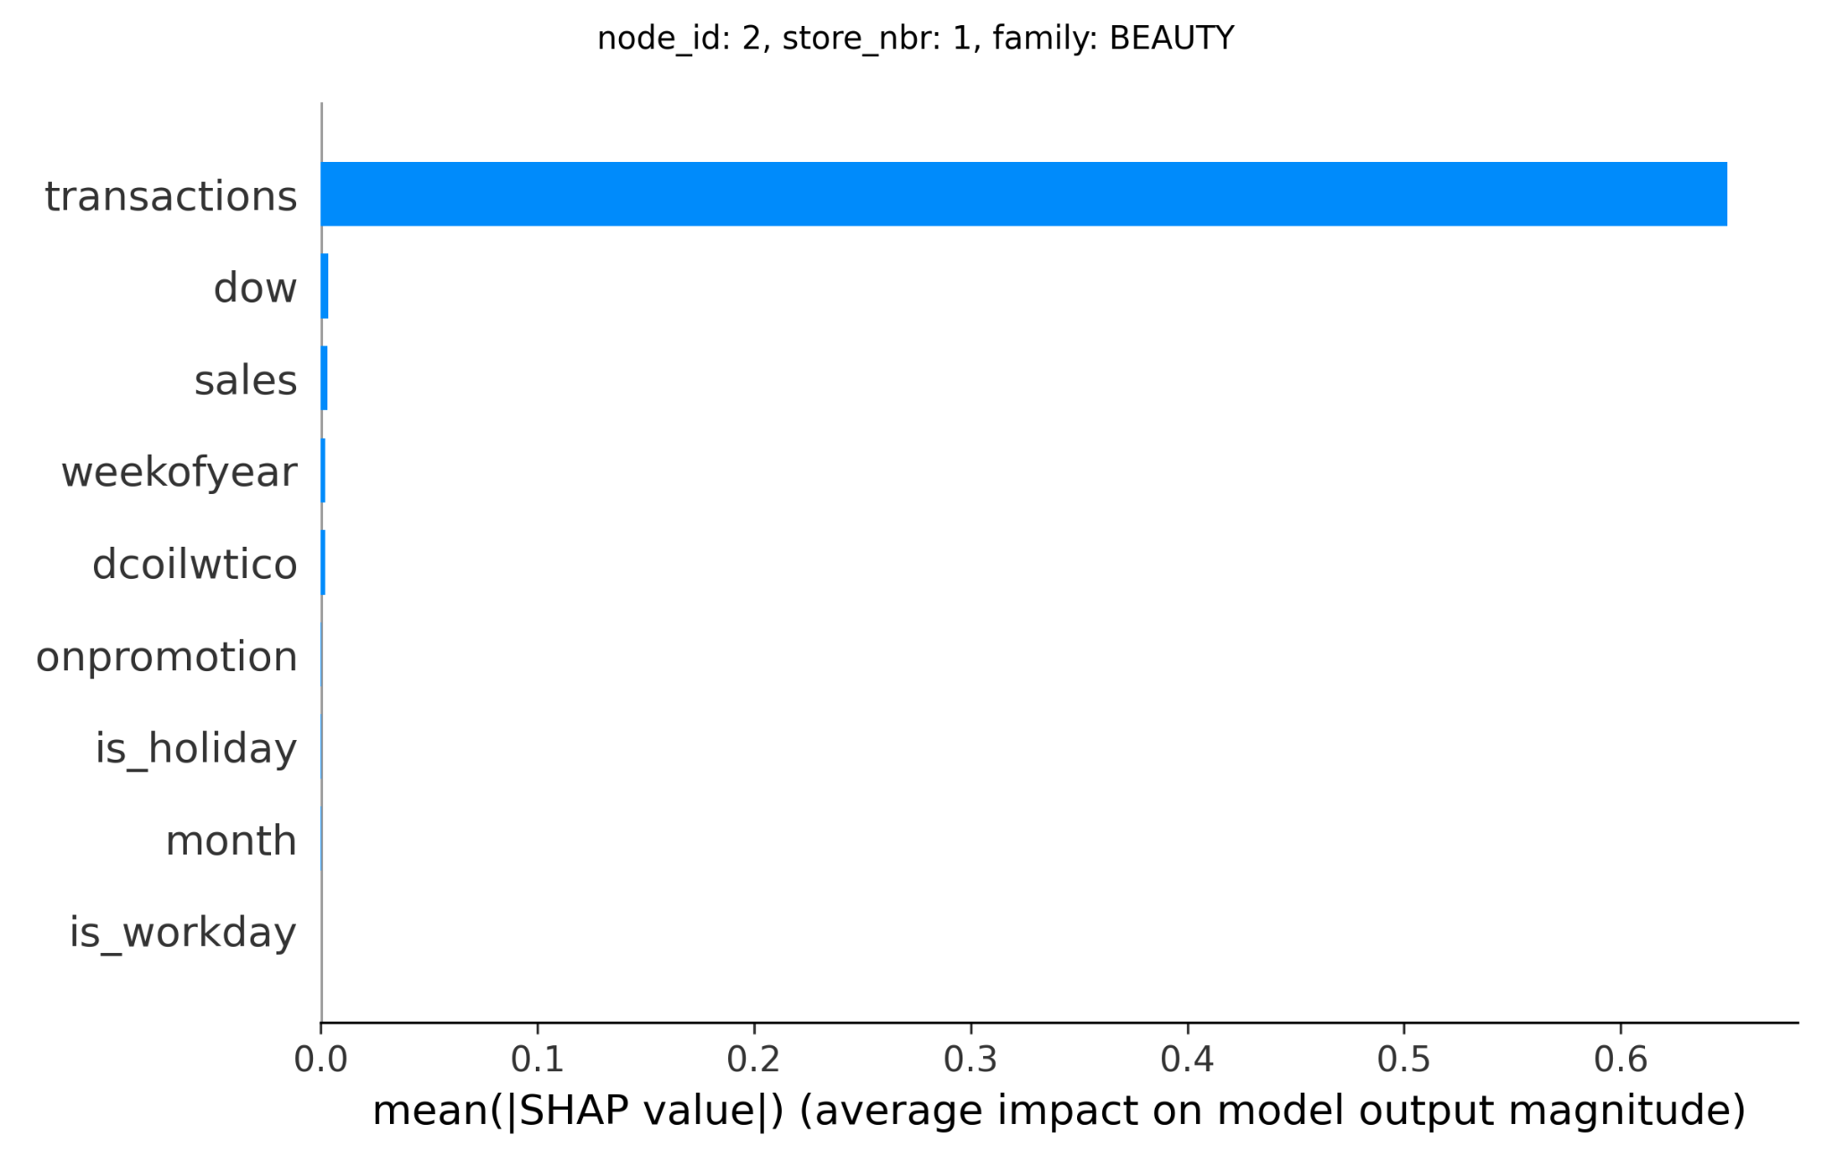
Feature-Level XAI: SHAP DeepExplainer
Feature | Mean absolute Shapley value
transactions | 0.6492
dow | 0.0033
sales | 0.0031
weekofyear | 0.0021
dcoilwtico | 0.0020
onpromotion | 0.0002
is_holiday | 0.0002
month | 0.0002
is_workday | 0.0
Figure 6.12 depicts the mean absolute Shapley values for each input feature, quantifying their relative contributions to the STGNN model’s predictions.
Transactions importance 0.6492 is by far the most influential feature, indicating that historical transaction attribute is the primary driver in the model’s demand predictions.
The next most important features—dow (day of week) 0.0033, sales 0.0031, weekofyear 0.0021, dcoilwtico (oil price indicator) 0.0020—have small but non-negligible impact.
Seasonality features such as promotional and calendar indicators - onpromotion 0.0002, is_holiday 0.0002, month 0.0002 - contribute minimally to the predictions.
Notably, is_workday has a mean absolute SHAP value of 0, indicating it has no contribution to the current model’s decision-making.

Slide 23
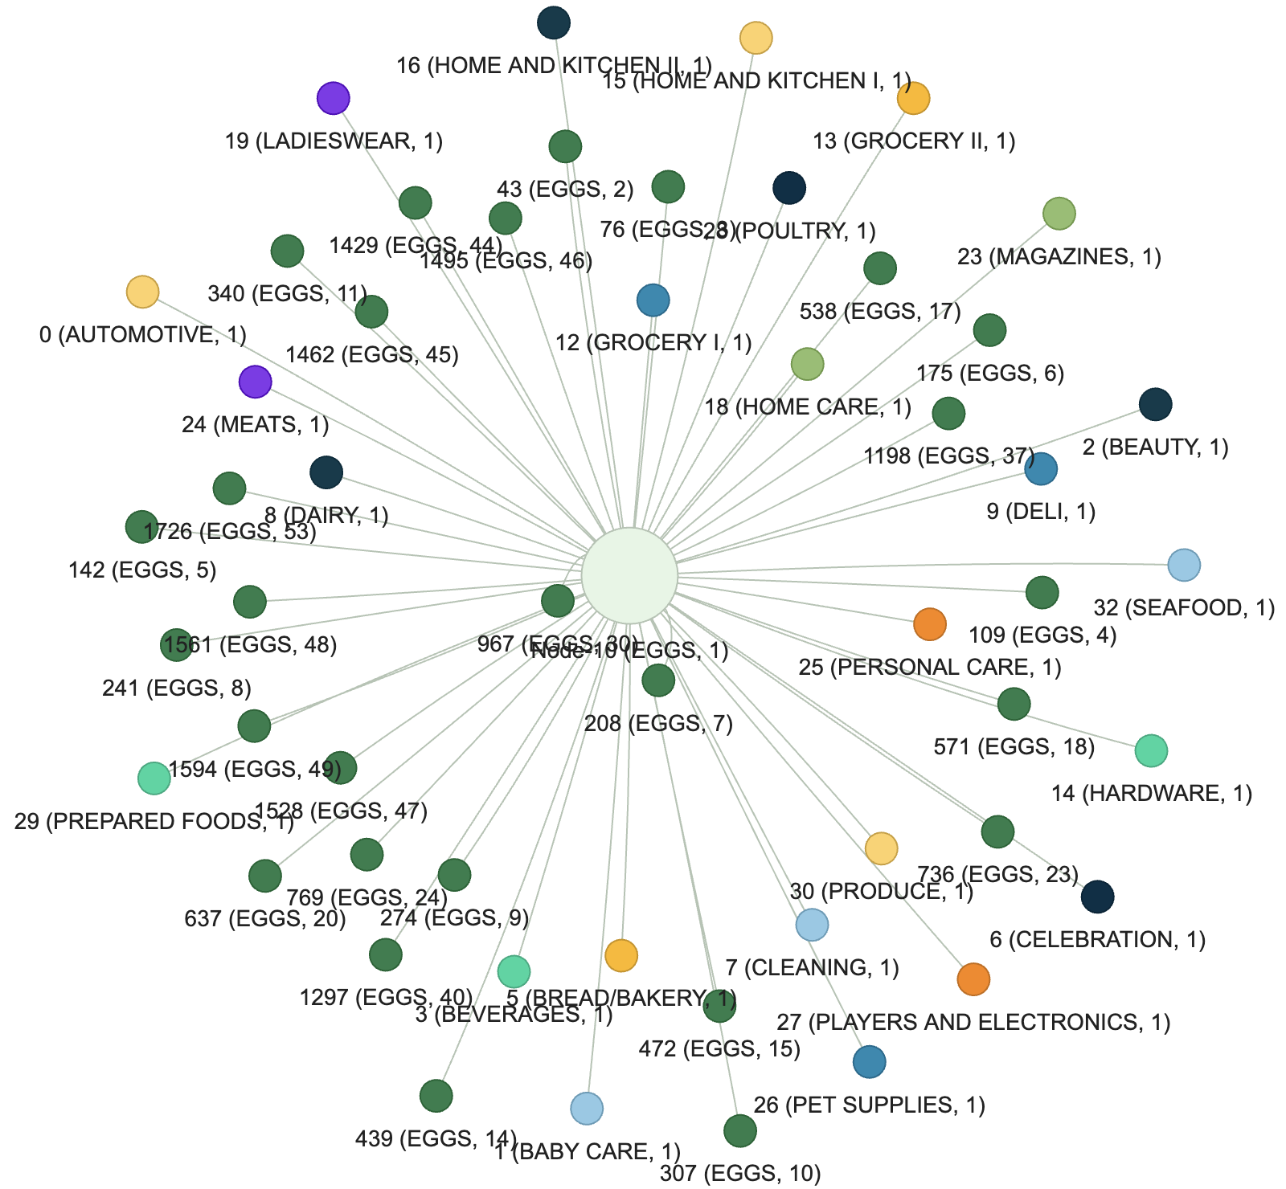
Structure-Level XAI
Custom Edge-Mask Explainer
Decision Influencing Neighbours
The underlying relationships of neighboring nodes is explained using the custom edge mask optimization methodology. This mask assigns a weight to each neighboring connection, representing its learned importance. The defined edge mask variable is optimized using gradient descent, incorporating L1 and entropy regularization. The optimization encourages the selection of the minimal necessary subset of connections, resulting in a sparse and interpretable mask. Thus the optimized edge mask quantifies the relative importance of each neighbour in forecasting the target node. Neighbors with larger mask values are interpreted as stores and products whose temporal patterns exert the greatest influence on the target node’s prediction. Figure 6.13 shows the node 10 (eggs product at store 1) neighbours that influence demand prediction of the product at store 10, see Appendix 10 for details.

Slide 24
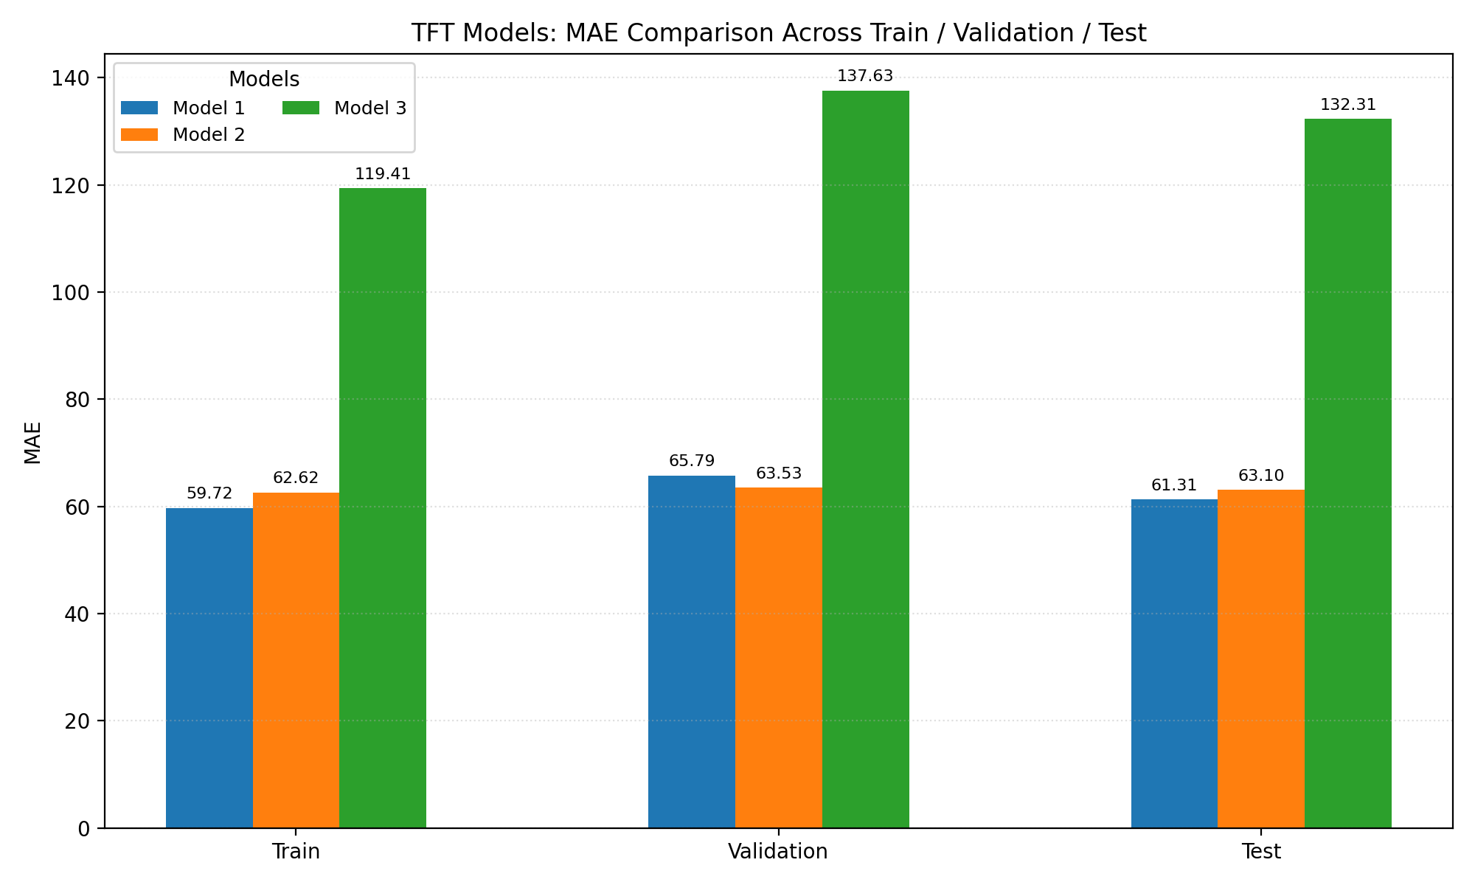
Performance
Parameters
--hidden: 64 --blocks: 3 --kernel: 3
--hidden: 32 --blocks: 3 --kernel: 3
--hidden: 16 --blocks: 1 --kernel: 1
The model training is conducted with a mini-batch size of 8, learning rate of 1×10⁻³, and a dropout rate of 0.1 to mitigate overfitting. The model is designed to estimate the conditional quantiles at levels 0.1, 0.5, and 0.9, thereby providing a probabilistic range of forecast outputs. To ensure the reproducibility of results, a random seed of 42 is set prior to training. Overfitting is further prevented by implementing early stopping, with a patience threshold of 5 epochs. Table 6.5 presents the experiment results of three model configurations.
From a computational standpoint, it is important to note that configuring the model with hidden size of 128 or greater leads to GPU A100 memory allocation errors. Consequently, the model’s hidden size is restricted to the maximum feasible model capacity within the available computational resources.
As demonstrated in Figure 6.14, the configuration designated as Model 1 achieves the highest performance on the test set, attaining an MAE value of 61.31 with the specified parameters.
Note from computational standpoint: configuring the model with hidden size of 128 or greater leads to GPU A100 memory allocation errors. Consequently, the model’s hidden size is restricted to the maximum feasible model capacity within the available computational resources.

Slide 25
Hybrid GNN-TFT
3
The proposed hybrid model integrates a GNN with a TFT to exploit both relational and temporal patterns in the input data. The architecture is composed of two primary components: the Relational Encoder and the TFT blocks.
The RE employs a GNN to create node embeddings, thereby capturing the relational structure among product family and store number entities. The node embeddings are concatenated with static input features, and then passed to the TFT block static covariate.
Architecturally, the RE block consists of two sequential Linear layers. Each linear layer is followed by a dropout layer and a ReLU activation function to promote regularization and non-linearity. Key hyperparameters for this block include the GNN input dimension, hidden dimension, output dimension, and dropout ratio.
The TFT component is responsible for multi-horizon time series forecasting and requires a range of configurable parameters such as data input dimensions for each input data feature that are encoder, decoder and static attributes. The model specific parameters are adjusted for hidden size, number of attention heads, LSTM size, dropout rate.
Figure 6.15 shows the seafood prediction at store 1, and Figure 6.16 shows the seafood product demand prediction across all Favorita stores.

Slide 26
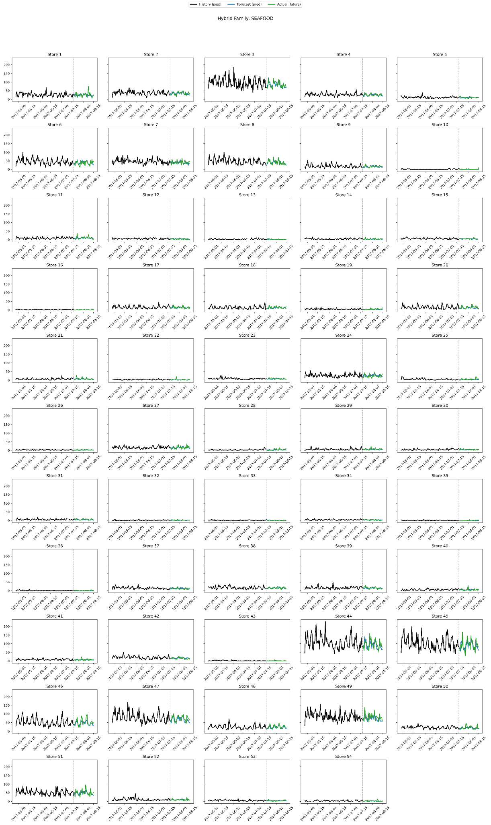
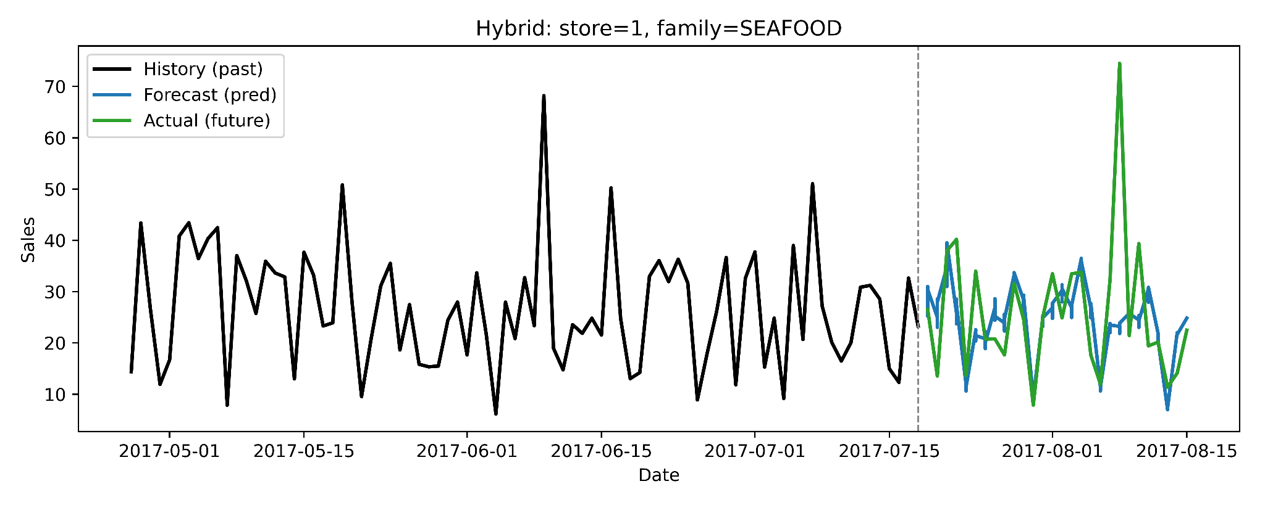
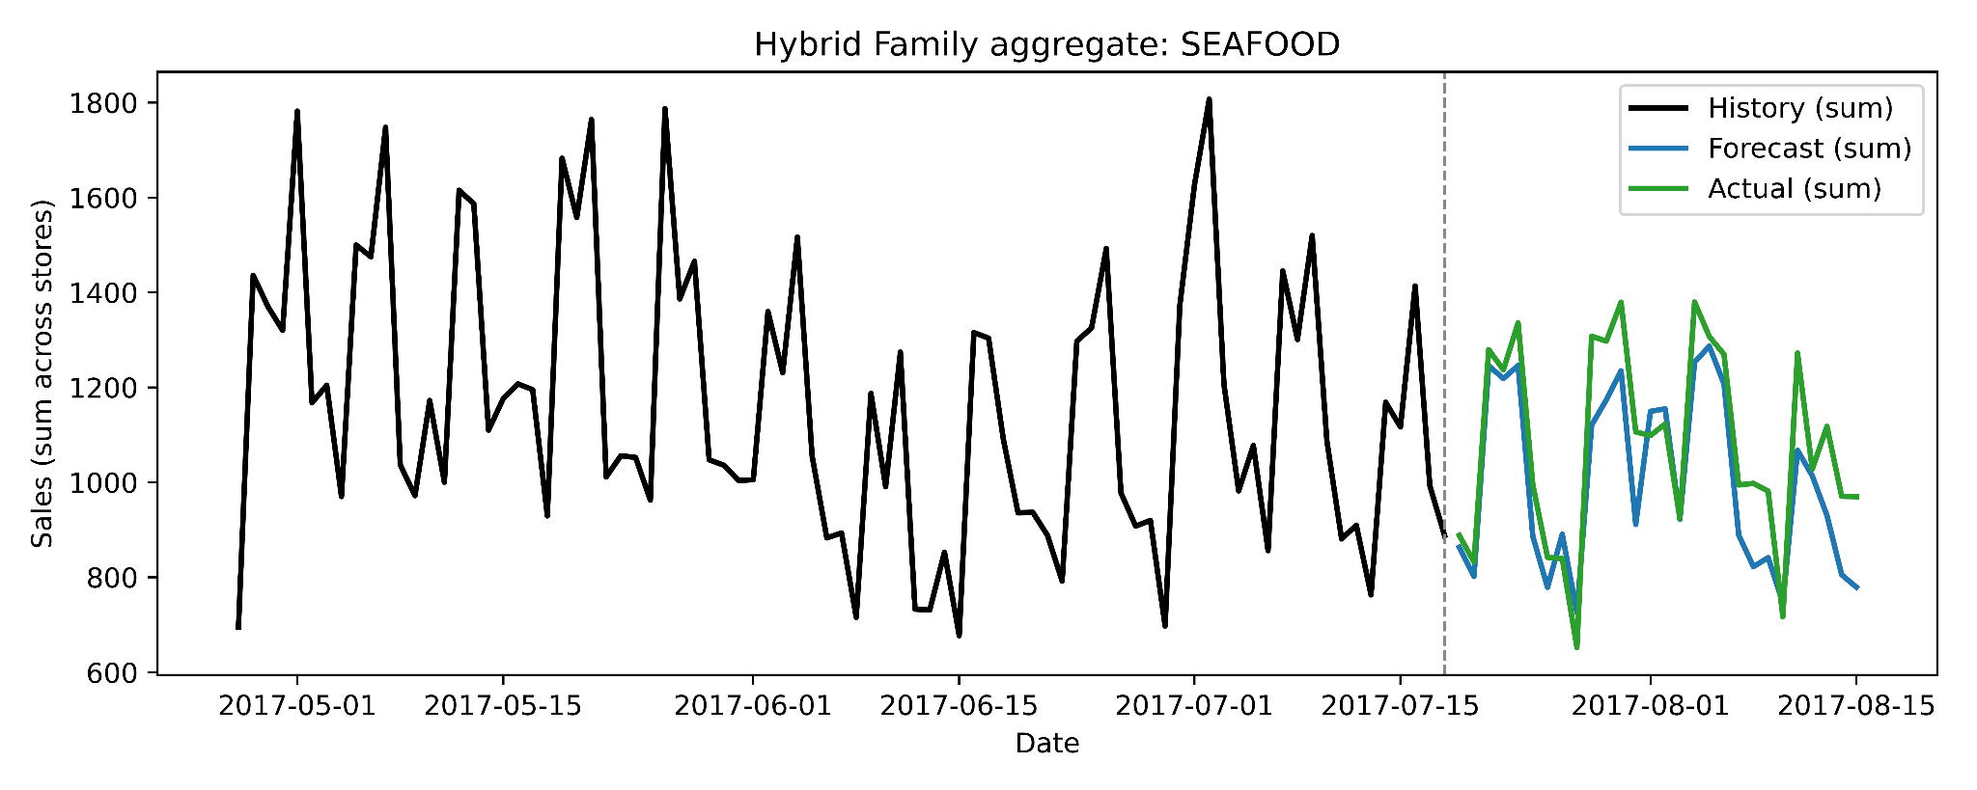
Hybrid Model
Figure 6.15 shows the seafood prediction at store 1, and Figure 6.16 shows the seafood product demand prediction across all Favorita stores.

Slide 27
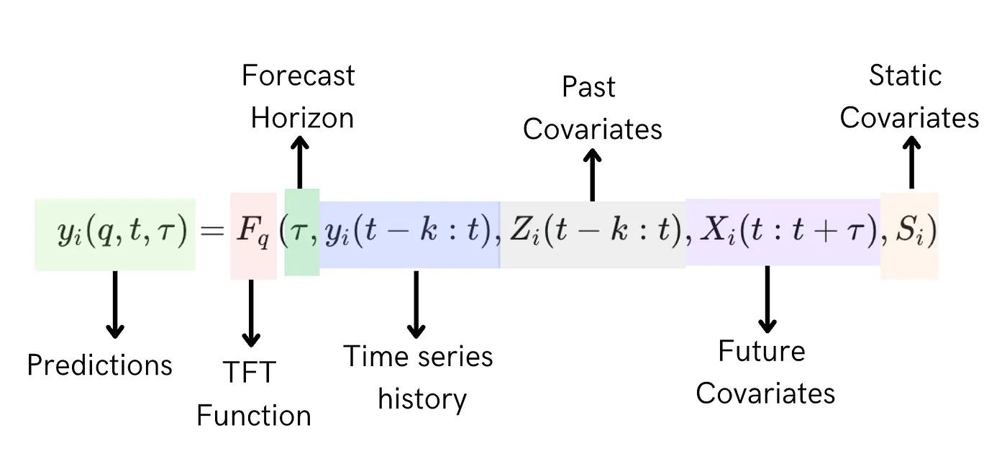
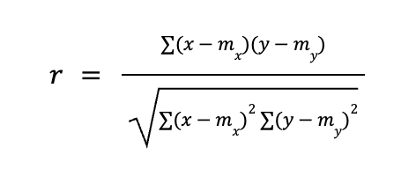
Hybrid Model Data
Exploits both relational and temporal patterns in the input data
Composed of two primary components: (1) Relational Encoder and (2) TFT
The RE employs a GNN to create node embeddings, thereby capturing the relational structure among product family and store number entities.
The node embeddings are concatenated with static input features, and then passed to the TFT block static covariate.
Node embeddings creation comprises the Pearson correlation coefficient computation

Slide 28
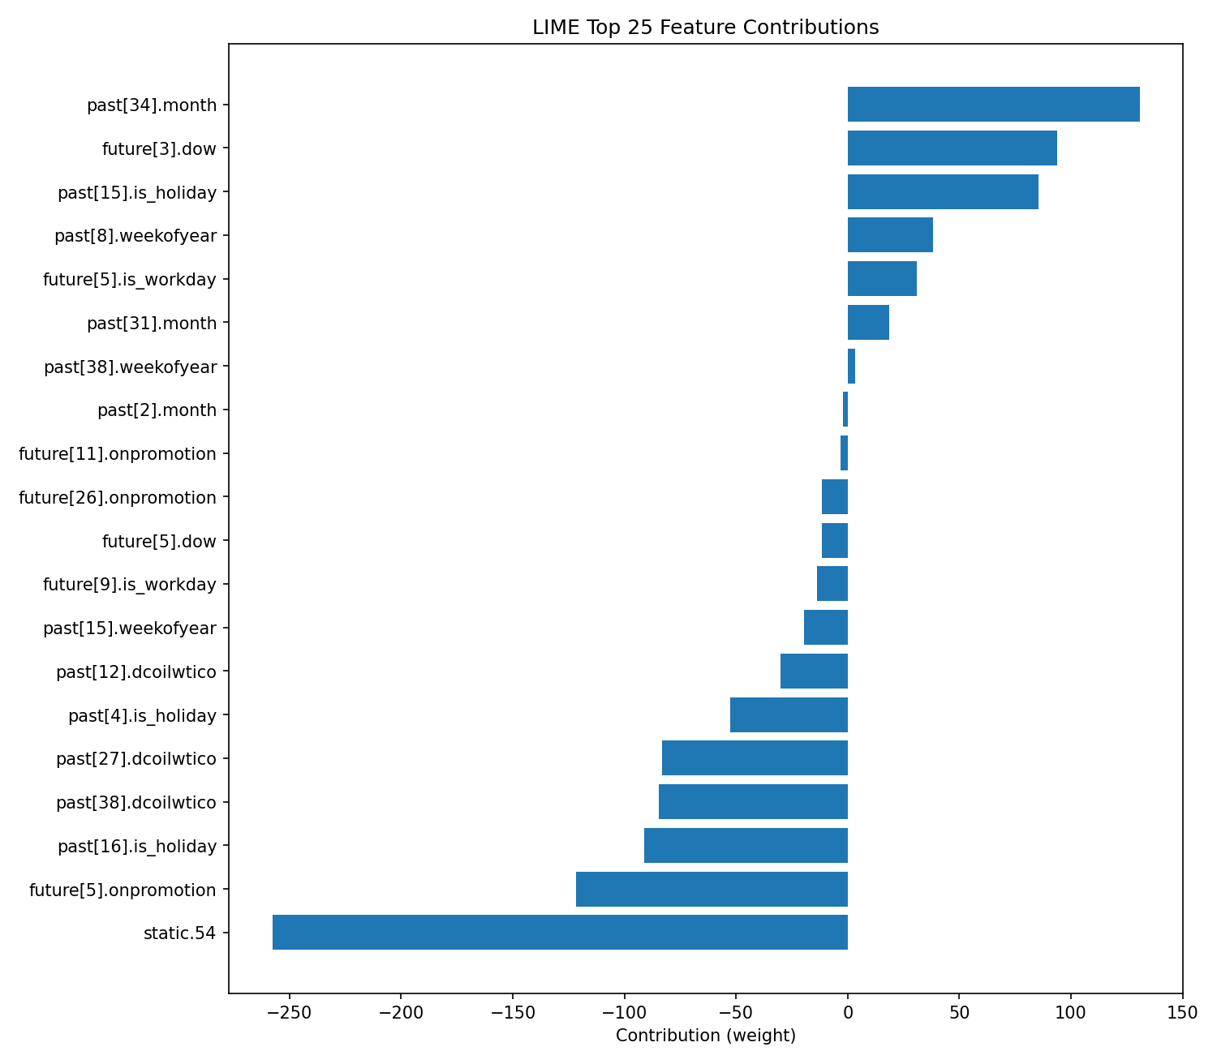
Hybrid XAI: LIME
Feature | Weight
past[34].month | 130.8142
future[3].dow | 93.7328
past[15].is_holiday | 85.4226
past[8].weekofyear | 38.0508
future[5].is_workday | 31.0180
past[31].month | 18.6158
past[38].weekofyear | 3.4062
past[2].month | -2.2726
future[11].onpromotion | -3.1617
future[26].onpromotion | -11.6736
future[5].dow | -11.7301
future[9].is_workday | -13.8870
past[15].weekofyear | -19.5332
past[12].dcoilwtico | -30.0725
past[4].is_holiday | -52.7784
past[27].dcoilwtico | -83.1999
past[38].dcoilwtico | -84.6973
past[16].is_holiday | -91.2767
future[5].onpromotion | -121.6794
static.54 | -257.7340
Several temporal features exhibit substantial positive influence on the model’s prediction. Notably, past[34].month (130.81), future[3].dow (93.73), and past[15].is_holiday (85.42) emerge as the most significant contributors, underscoring pronounced dependencies on seasonality, day-of-week, and historical holiday effects in the forecast. Additional temporal and calendar-related features, such as past[8].weekofyear (38.06), future[5].is_workday (31.02), past[31].month (18.62), and past[38].weekofyear (3.41), also positively influence predictions, indicating the hybrid model’s sensitivity to recurring temporal cycles and workday patterns.
Conversely, several features display notable negative contributions, acting to suppress the predicted value. Among these, the static feature static.54 (weight = -257.73) has the most pronounced impact, suggesting that this specific static attribute is strongly associated with reduced forecast outputs. Other features exhibiting negative weights include future[5].onpromotion (-121.68), past[16].is_holiday (-91.28), past[38].dcoilwtico (-84.70), past[27].dcoilwtico (-83.20), past[4].is_holiday (-52.78), past[12].dcoilwtico (-30.07), and past[15].weekofyear (-19.53). These results suggest that certain promotional periods, holidays, and economic indicators (oil prices) have a reducing effect on the model’s demand prediction for the analyzed instance.
Taken together, the LIME analysis reveals that the hybrid model’s prediction for store number 1 and product family AUTOMOTIVE is primarily driven by its temporal features, particularly those reflecting seasonality and calendar events. In contrast, several static and external variables exert a substantial negative influence.

Slide 29
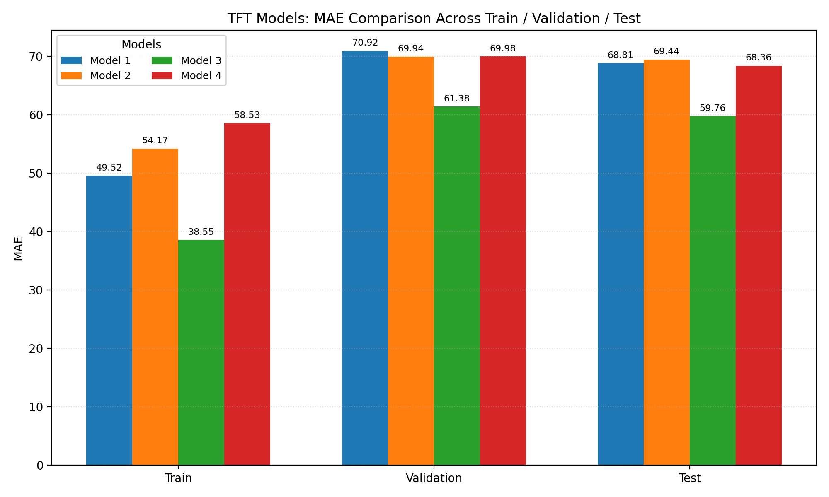
Hybrid Model Performance
Parameters
--hidden-dim: 128 --d-mode: 64 --heads: 4 --lstm-hidden: 64 --lstm-layers: 1 --gnn-hidden: 64 --gnn-embed: 32
--hidden-dim: 64 --d-mode: 32 --heads: 4 --lstm-hidden: 32 --lstm-layers: 1 --gnn-hidden: 32 --gnn-embed: 16
--hidden-dim: 256 --d-model: 128 --heads: 8 --lstm-hidden: 64 --lstm-layers: 3 --gnn-hidden: 128 --gnn-embed: 64
--hidden-dim: 32 --d-model: 16 --heads: 2 --lstm-hidden: 32 --lstm-layers: 1 --gnn-hidden: 16 --gnn-embed: 8
Among the four evaluated configurations of hybrid model parameters, Model 3 demonstrated the best performance, achieving the lowest MAE of 59.76 on the test set (see Figure 6.18).

Slide 30
Model Performance Comparison
Key Points
TFT: Captures temporal sales patterns well, competitive MAE and WAPE.
GNN: Effective for structural and relational
features; close results to TFT.
Hybrid: Outperforms both, leveraging both temporal & relational aspects.
Model | Best Configuration | MAE | WAPE | SMAPE | Comments
ARIMA | order=(2,1,3) | 4175.6045 | 0.1630 | 0.3366 | Statistical baseline. Significantly higher error
Linear Regression | Sklearn model fit | 315.7444 | 0.8446 | 1.4174 | Baseline Model. High error.
GNN | hidden=64 blocks=3 kernel=3 | 61.31 | 0.1286 | 0.5831 | Comparable to best TFT
Hybrid | hidden=256 emb=128 heads=8 LSTM=64×3 GNN=128 | 59.76 | 0.1253 | 0.5971 | Best overall (lower MAE, WAPE)

Slide 31
Summary
The highest performance - Hybrid model with 59.76 MAE
Difference - (1) ARIMA 4115,8445 and Linear Regression 255,9844 (2) 1,6 from TFT (3) 1,55 difference from GNN
The highly impacting features - future promotion, holiday, oil price, product family type, transactions, month, day-of-week, holidays
The least impacting features - future workday, static metadata like state, cluster, family, store number, and the concatenated static features (node embeddings and static attributes)
Although the performance of the hybrid model was high using concatenated static features, XAI analysis showed that static features had the greatest negative impact on the results
Experimental evaluation of key structural parameters demonstrates that tuning hidden layer dimensions, embedding sizes, attention heads, and network depth can markedly impact the predictive accuracy

Slide 32
Feasibility and Business Recommendations
Future Work
The modeling framework can be extended to finer levels of granularity (e.g., individual SKUs or regional clusters) if higher-resolution data is available, further enhancing operational precision.
Store owners and managers can use the forecasts to proactively adjust inventory, optimize promotional campaigns, and prepare staffing according to expected demand fluctuations in the next 28 days.
Accurate multi-horizon forecasts allow for better allocation of capital towards inventory purchases, minimizing both stockouts and excess.
Promotions and discounts can be strategically scheduled based on periods of forecasted lower demand, while high-demand periods can be leveraged for pricing optimization.
The use of model interpretation techniques provides actionable insights into which factors drive demand, supporting evidence-based decision making for both short-term and strategic interventions.
Demand Planning
Resource Allocation
Strategic Marketing
Explainability
Scalability

Slide 33
Research Objectives and Solutions
Research Objectives | How?
To evaluate and compare the forecasting accuracy of GNN, TFT, and hybrid GNN-TFT models. | - Developed each model using PyTorch. - Preprocessed and split the dataset. - Trained on Google Colab (A100, L4, T4 GPUs). - Performance measured by MAE, WAPE, and SMAPE.
To interpret model predictions by applying both model-specific and model-agnostic explainable AI (XAI) methods. | - TFT: Model-agnostic and intrinsic (built-in) XAI methods. - GNN: SHAP for feature-level, edge mask optimizer for neighbor-level explanations. - Hybrid: LIME for interpretability.
To find and implement architectural improvements, aiming to maximize predictive performance and operational value of models. | Trained models using various combinations of architectural parameters: • TFT: Hidden dim, model dim, heads, LSTM hidden, LSTM layers, dropout (4 combinations). • GNN: Hidden units, blocks, kernel sizes (3 combinations). • Hybrid: Hidden dim, model dim, heads, LSTM hidden, LSTM layers, GNN hidden, GNN embedding (4 combinations).

Slide 34
Thank you for your attention!
Q & A

